Slide 1

ENERGY EFFICIENCY IMPROVEMENTS OF RESIDENTIAL HOMES NEW YORK STATE – A CASE STUDY
Leo Krohne | Lukas Bauerschmidt | 10th of February 2023

Slide 2




Was the project successful up until now?
Goal: Governmental Initiative starting in 2010 - 2021 to reduce energy use in the State’s residential buildings
MODEL
What are areas to improve in future projects?
Target Group: Households with income up to 80% of the State or Median County Income
How it the project working?
What are areas to improve in future projects?
PROJECT BACKGROUND
Government
2. Contract
1. Application
HYPOTHESES
3. Delivery
Green Jobs Green New York
3 Main Questions to Answer
Contractors
Households

Slide 3




From Data to Insights
PROCESS
RAW DATASET
RESEARCH
DATA CLEANING
Kaggle Dataset
29 Columns x 55.2k Rows
I Row = 1 Project
Understand features & unique categories
XYZ
Unified Columns
Removed outliers
Created new categories
VISUALIZATION
Gained Insights
H

Slide 4

Analytics
DASHBOARD
YOUR TITLE HERE
YOUR TITLE HERE
YOUR TITLE HERE

Slide 5
FASHUP
MAIN FINDINGS
FASHUP’S ANALYSIS FOUND OUT THAT CUSTOMERS INCREASINGLY FACE PROBLEMS LIKE ...
FRAGMENTED
SUPPLY
TIME CONSUMING
2nd HAND SHOPPING
Vinted, Depop, Vestiaire Collective, ThreadUp, Stationary Retail
Browsing multiple platforms to find matching outfit
NO PERSONALIZED
SUGGESTIONS
INFLATED
PRICES
Not addressing customer need of matching customer outfits
Rising inflation drives consumer prices:
2021: 3.1%
Notes:
● At the beginning of our project phase, our team had an intense brainstorming session about nowadays second hand shopping
● We identified 4 major problems:
1.) First, there seems to be a fragmented supply, meaning there are several plattforms offering second hand clothes
2.) This implies that second hand shopping is time consuming, since users need to browse through multiple plattforms to find the right clothing items
3.) Thirdly, most of these second hand websites do not offer personalized suggestions
4.) And lastly, due to the current inflation, prices of new clothing items seems to rise significantly
● But before we started creating a product, matching these problems, we tried to better understand the market we aimed to penetrate as well as its consumer.

Slide 6
1. What business problem are you solving + Machine Learning problem (30s-1m) (1 Slide) (@Samuel)
Probleme im Bereich Marketing
Potentiale Data Analytics im Bereich Marketing aufzeigen
CTR als main KPI aufzeigen
Problem: Classification nennen
2. Explorative data analysis & data preparation (20s) (1 Slides) (@Chris)
1 Slide mit 1-2 Graphen ohne Text (key Takeaways von EDA)
3. Machine learning models 2-3 min (2 Slides) (@Lukas)
6 Modelle + Warum
Evaluation Metric + warum
Vorgehensweise (trichter)
Best Performing Model
4. Evaluating and interpreting machine learning models (1-2 Slide) (@Samuel)
Bezug zu Business Case ziehen
Wie könnte unser Modell die Probleme im marketing beheben
Was ist der Main Benefit von unserem Modell

Slide 7
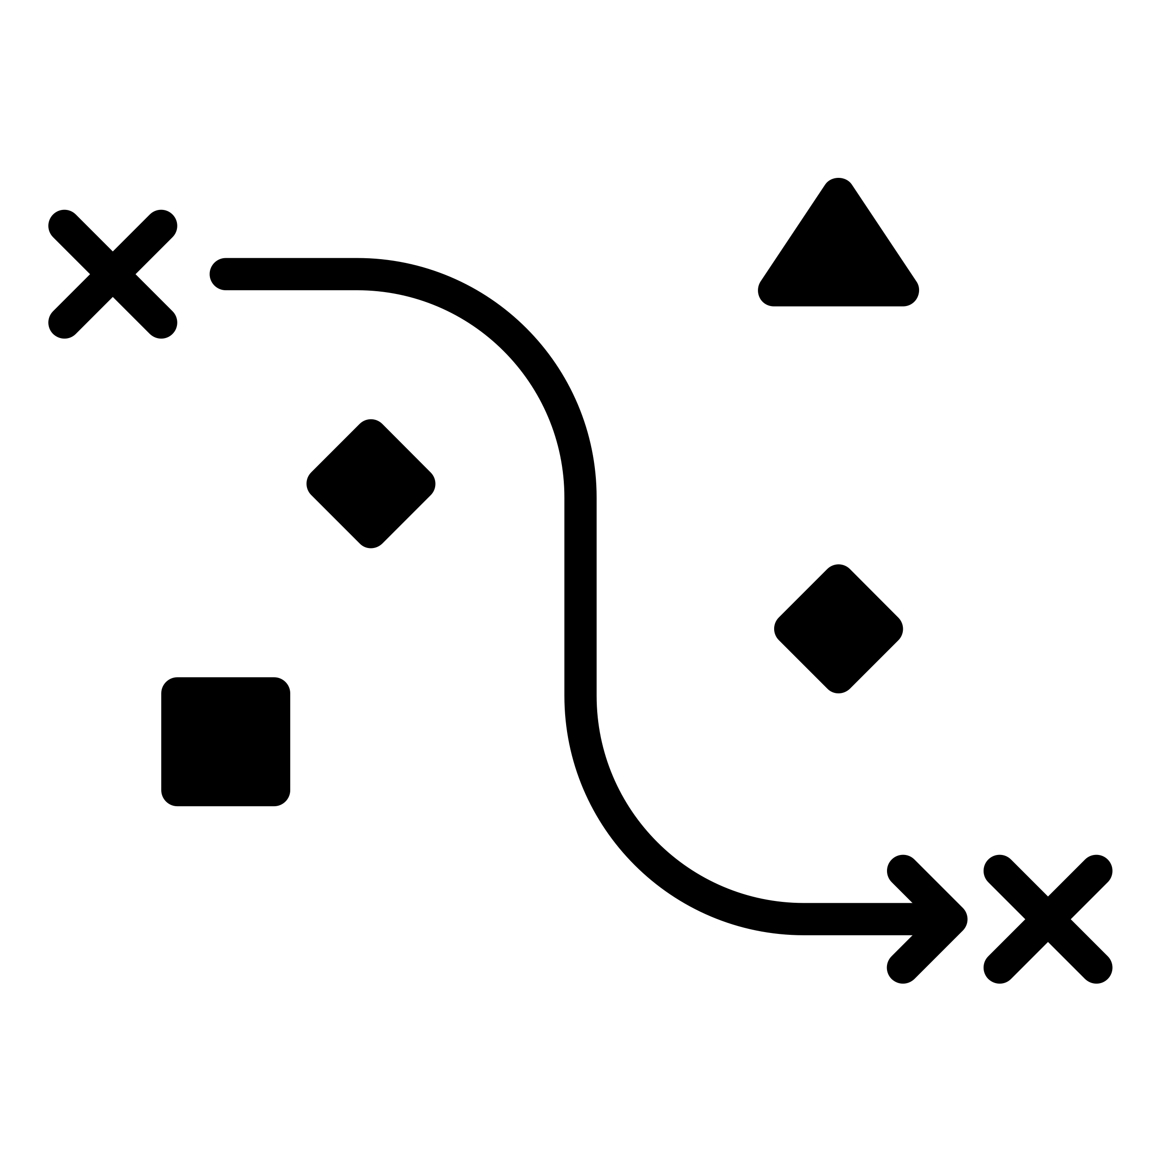
Was the project successful up until now?
PROJECT
BACKGROUND
What are areas to improve in future projects?
What are areas to improve in future projects?
Green Jobs Green New York
What are areas to improve in future projects?
Goal: Governmental Initiative starting in 2010 - current to reduce energy use in the State’s residential buildings
Target Group: Households with income up to 80% of the State or Median County Income
HYPOTHESES
3 Main Questions to Answer
2. Contract
3. Delivery
Functionality:
GVMT
CTRCTS
HHOLDS
1. Application
H

Slide 8
YOU CAN WRITE HERE
A LITTLE BIT
OF HISTORY
A company is an association or collection of individuals, whether natural persons, legal persons, or a mixture of both. Company members share a common purpose and unite in order to focus their various talents and organize their collectively available skills or resources to achieve specific, declared goals.
A company is an association or collection of individuals, whether natural persons, legal persons, or a mixture of both. Company members share a common purpose and unite in order to focus their various talents and organize their collectively available skills or resources to achieve specific, declared goals.
LEARN MORE

Slide 9
YOU CAN WRITE HERE
YOUR TITLE
GOES HERE
Entrepreneurial activities differ substantially depending on the type of organization
YOU CAN WRITE HERE
YOUR TITLE
GOES HERE
Entrepreneurial activities differ substantially depending on the type of organization

Slide 10
YOU CAN WRITE HERE
OUR WELCOME
MESSAGE FROM OUR CEO
A company is an association or collection of individuals, whether natural persons, legal persons, or a mixture of both. Company members share a common purpose and unite in order to focus.
A company is an association or collection of individuals, whether natural persons, legal persons, or a mixture of both. Company members share a common purpose and unite in order to focus their various talents and organize their collectively available skills or
YOU CAN WRITE HERE
MR. DOE
CEO & FOUNDER
Entrepreneurial activities differ substantially depending on the type of organization

Slide 11
WRITE HERE SOMETHING
OUR GOALS
Entrepreneurial activities differ substantially depending on the type of organization
YOUR TITLE
YOUR TITLE
Entrepreneurial activities differ substantially
Entrepreneurial activities differ substantially
YOUR TITLE
YOUR TITLE
Entrepreneurial activities differ substantially
Entrepreneurial activities differ substantially

Slide 12
YOU CAN WRITE HERE
A FULL WIDTH TEXT
A company is an association or collection of individuals, whether natural persons, legal persons, or a mixture of both. Company members share a common purpose and unite in order to focus their various talents and organize their collectively available skills or resources to achieve specific, declared goals. A company or association of persons can be created at law as legal person so that the company in itself can accept Limited liability for civil responsibility and taxation incurred as members perform (or fail) to discharge their duty within the publicly declared "birth certificate" or published policy. Because companies are legal persons, they also may associate and register themselves as companies – often known as a corporate group. When the company closes it may need a "death certificate" to avoid further legal obligations
A company or association of persons can be created at law as legal person so that the company in itself can accept Limited liability for civil responsibility and taxation incurred as members perform (or fail) to discharge their duty within the publicly declared "birth certificate" or published policy. A company or association of persons can be created at law as legal person so that the company in itself can accept Limited liability for civil responsibility and taxation incurred as members perform (or fail) to discharge their duty within the publicly declared "birth certificate" or published policy. A company or association of persons can be created at law as legal person so that the company in itself can accept Limited liability for civil responsibility and taxation incurred as members perform (or fail) to discharge their duty within the publicly declared "birth certificate" or published policy.

Slide 13
YOU CAN WRITE HERE
TWO COLUMNS TEXT
A company is an association or collection of individuals, whether natural persons, legal persons, or a mixture of both. Company members share a common purpose and unite in order to focus their various talents and organize their collectively available skills or resources to achieve specific, declared goals. A company or association of persons can be created at law as legal person so that the company in itself can accept Limited liability for civil responsibility and taxation incurred as members perform (or fail) to discharge their duty within the publicly declared "birth certificate" or published policy. Because companies are legal persons, they also may associate and register themselves as companies – often known as a corporate group. When the company closes it may need a "death certificate" to avoid further legal.
A company or association of persons can be created at law as legal person so that the company in itself can accept Limited liability for civil responsibility and taxation incurred as members perform (or fail) to discharge their duty within the publicly declared "birth certificate" or published policy. A company or association of persons can be created at law as legal person so that the company in itself can accept Limited liability for civil responsibility and taxation incurred as members perform (or fail) to discharge their duty within the publicly declared "birth certificate" or published policy. A company or association of persons can be

Slide 14
YOU CAN WRITE HERE
THREE COLUMNS TEXT
A company is an association or collection of individuals, whether natural persons, legal persons, or a mixture of both. Company members share a common purpose and unite in order to focus their various talents and organize their collectively available skills or resources to achieve specific, declared goals. A company or association of persons can be created at law as legal person so that the company in itself can accept Limited liability for civil responsibility and taxation incurred as members perform (or fail) to discharge their duty within the publicly declared "birth certificate" or published policy. Because companies are legal persons, they also may associate and register themselves as companies – often known as a corporate group. When the company closes it may need a "death certificate" to avoid further legal.
A company is an association or collection of individuals, whether natural persons, legal persons, or a mixture of both. Company members share a common purpose and unite in order to focus their various talents and organize their collectively available skills or resources to achieve specific, declared goals. A company or association of persons can be created at law as legal person so that the company in itself can accept Limited liability for civil responsibility and taxation incurred as members perform (or fail) to discharge their duty within the publicly declared "birth certificate" or published policy. Because companies are legal persons, they also may associate and register themselves as companies – often known as a corporate group. When the company closes it may need a "death certificate" to avoid further legal.
A company is an association or collection of individuals, whether natural persons, legal persons, or a mixture of both. Company members share a common purpose and unite in order to focus their various talents and organize their collectively available skills or resources to achieve specific, declared goals. A company or association of persons can be created at law as legal person so that the company in itself can accept Limited liability for civil responsibility and taxation incurred as members perform (or fail) to

Slide 15
YOU CAN WRITE HERE
BULLETED LIST TEXT
YOUR TITLE HERE
A company is an association or collection of individuals, whether natural persons, legal persons, or a mixture of both. Company members share a common purpose and unite in order to focus their various talents and organize their collectively available skills
YOUR TITLE HERE
A company is an association or collection of individuals, whether natural persons, legal persons, or a mixture of both. Company members share a common purpose and unite in order to focus their various talents and organize their collectively available skills
YOUR TITLE HERE
A company is an association or collection of individuals, whether natural persons, legal persons, or a mixture of both. Company members share a common purpose and unite in order to focus their various talents and organize their collectively available skills

Slide 16
WRITE HERE SOMETHING
WRITE HERE
YOUR TITLE
A company is an association or collection of individuals, whether natural persons, legal persons, or a mixture of both. Company members share a common purpose and unite in order to focus their various talents and organize their collectively available.
A company is an association or collection of individuals, whether natural persons, legal persons, or a mixture of both. Company members share a common purpose and unite in order to focus their various talents and organize their collectively available.
A company is an association or collection of individuals, whether natural persons, legal persons, or a mixture of both. Company members share a common purpose and unite in order to focus their various talents and organize their collectively available.

Slide 17
YOU CAN WRITE HERE
MEET OUR TEAM
JOHN DOE
JOHN DOE
JOHN DOE
JOHN DOE
JOHN DOE
A company is an association or
A company is an association or
A company is an association or
A company is an association or
A company is an association or,

Slide 18


YOU CAN WRITE HERE
MEET OUR TEAM
JAMES BOND
STEVE JOBS
BRUCE W.
KAREN C.
A company is an association or collection of
A company is an association or collection of
A company is an association or collection of
A company is an association or collection of
MARK Z.
BRIAN T.
THELMA T.
MARY JANE
A company is an association or collection of
A company is an association or collection of
A company is an association or collection of
A company is an association or collection of

Slide 19
YOU CAN WRITE HERE
MEET OUR AWESOME TEAM
A company is an association or collection of individuals, whether natural persons, legal persons, or a mixture of both. Company members share a common purpose and unite in order to focus.
JOHN DOE
CEO & FOUNDER
PETER PT.
CEO & FOUNDER
JOHNY DEPP
CEO & FOUNDER
A company is an association or collection of individuals, whether
A company is an association or collection of individuals, whether
A company is an association or collection of individuals, whether
TONY STARK
CEO & FOUNDER
BRUCE W.
CEO & FOUNDER
MARK Z.
CEO & FOUNDER
A company is an association or collection of individuals, whether
A company is an association or collection of individuals, whether
A company is an association or collection of individuals, whether
MARY JANE
CEO & FOUNDER
JAMES BOND
CEO & FOUNDER
BRIAN T.
CEO & FOUNDER
A company is an association or collection of individuals, whether
A company is an association or collection of individuals, whether
A company is an association or collection of individuals, whether

Slide 20
YOU CAN WRITE HERE
MEET OUR TEAM
JOHN DOE
CEO & FOUNDER
JOHN DOE
CEO & FOUNDER
A company is an association or collection of individuals, whether
A company is an association or collection of individuals, whether
JOHN DOE
CEO & FOUNDER
JOHN DOE
CEO & FOUNDER
A company is an association or collection of individuals, whether
A company is an association or collection of individuals, whether

Slide 21
JOHN DOE
CEO & FOUNDER
A company is an association or collection of

Slide 22
JOHN DOE
CEO & FOUNDER
A company is an association or collection of

Slide 23
YOU CAN WRITE HERE
MEET MR. JOHN DOE
A company is an association or collection of individuals, whether natural persons, legal persons, or a mixture of both. Company members share a common purpose and unite in order to focus.
A company is an association or collection of individuals, whether natural persons, legal persons, or a mixture of both. Company members share a common purpose and unite in order to focus their various talents and organize their collectively available skills or resources to achieve specific, declared goals.
A company or association of persons can be created at law as legal person so that the company in itself can accept Limited liability for civil responsibility and taxation incurred as members perform (or fail) to discharge their duty within the publicly declared "birth certificate" or published policy.
JOHN DOE
CEO & FOUNDER
A company is an association or collection of individuals, whether natural persons, legal persons, or a mixture of

Slide 24
YOU CAN WRITE HERE
MEET OUR
AWESOME TEAM
Entrepreneurial activities differ substantially depending on the type of organization

Slide 25
YOU CAN WRITE HERE
WRITE HERE A NICE TITLE
YOUR TITLE HERE
YOUR TITLE HERE
A company is an association or collection of individuals, whether natural persons, legal persons, or a mixture of both. Company members share a common purpose and unite in order to focus their various talents and organize their collectively available skills
A company is an association or collection of individuals, whether natural persons, legal persons, or a mixture of both. Company members share a common purpose and unite in order to focus their various talents and organize their collectively available skills

Slide 26
YOU CAN WRITE HERE
WRITE HERE A NICE TITLE
YOUR TITLE HERE
YOUR TITLE HERE
YOUR TITLE HERE
A company is an association or collection of individuals, whether natural persons, legal persons, or a mixture of both. Company members
A company is an association or collection of individuals, whether natural persons, legal persons, or a mixture of both. Company members
A company is an association or collection of individuals, whether natural persons, legal persons, or a mixture of both. Company members
YOUR TITLE HERE
YOUR TITLE HERE
YOUR TITLE HERE
A company is an association or collection of individuals, whether natural persons, legal persons, or a mixture of both. Company members
A company is an association or collection of individuals, whether natural persons, legal persons, or a mixture of both. Company members
A company is an association or collection of individuals, whether natural persons, legal persons, or a mixture of both. Company members

Slide 27
YOU CAN WRITE HERE
OUR SERVICES
A company is an association or collection of individuals, whether natural persons, legal persons, or a mixture of both. Company members share a common purpose and unite in order to focus.
YOUR TITLE HERE
YOUR TITLE HERE
YOUR TITLE HERE
A company is an association or collection of individuals, whether natural persons, legal persons, or a mixture of both. Company members
A company is an association or collection of individuals, whether natural persons, legal persons, or a mixture of both. Company members
A company is an association or collection of individuals, whether natural persons, legal persons, or a mixture of both. Company members

Slide 28
YOU CAN WRITE HERE
OUR SERVICES
A company is an association or collection of individuals, whether natural persons, legal persons, or a mixture of both. Company members share a common purpose and unite in order to focus.
YOUR TITLE
YOUR TITLE
YOUR TITLE
A company is an association or collection of
A company is an association or collection of
A company is an association or collection of
YOUR TITLE
YOUR TITLE
YOUR TITLE
A company is an association or collection of
A company is an association or collection of
A company is an association or collection of
YOUR TITLE
YOUR TITLE
YOUR TITLE
A company is an association or collection of
A company is an association or collection of
A company is an association or collection of

Slide 29
YOU CAN WRITE HERE
FUNNY FACTS
A company is an association or collection of individuals, whether natural persons, legal persons, or a mixture of both. Company members share a common purpose and unite in order to focus.
229
1575
71
MESSAGES SENT
PROJECTS
STARS
A company is an association or collection of individuals, whether
A company is an association or collection of individuals, whether
A company is an association or collection of individuals, whether

Slide 30
“It is better to fail in originality than to succeed in imitation.”
Herman Melville

Slide 31
“It is better to fail in originality than to succeed in imitation.”
Herman Melville

Slide 33

MARK ZUCKERBERG
FACEBOOK COMPANY
A company is an association or collection of individuals, whether natural persons, legal persons, or a mixture of both. Company members share a common purpose and unite in order to focus their various talents and organize their collectively available skills or

Slide 34
YOUR TITLE HERE
YOUR TITLE HERE
YOUR TITLE HERE
A company is an association or collection of individuals, whether natural persons, legal persons, or a
A company is an association or collection of individuals, whether natural persons, legal persons, or a
A company is an association or collection of individuals, whether natural persons, legal persons, or a
YOUR TITLE HERE
YOUR TITLE HERE
YOUR TITLE HERE
A company is an association or collection of individuals, whether natural persons, legal persons, or a
A company is an association or collection of individuals, whether natural persons, legal persons, or a
A company is an association or collection of individuals, whether natural persons, legal persons, or a

Slide 35
YOU CAN WRITE HERE
SUBSCRIBING PLANS
A company is an association or collection of individuals, whether natural persons, legal persons, or a mixture of both. Company members share a common purpose and unite in order to focus.
PERSONAL
BUSINESS
ENTERPRISE
FREE
$79/MO
$199/MO
A company is an association or collection of individuals, whether natural persons, legal persons, or
A company is an association or collection of individuals, whether natural persons, legal persons, or
A company is an association or collection of individuals, whether natural persons, legal persons, or
LEARN MORE
LEARN MORE
LEARN MORE

Slide 36
YOU CAN WRITE HERE
SUBSCRIBING PLANS
A company is an association or collection of individuals, whether natural persons, legal persons, or a mixture of both. Company members share a common purpose and unite in order to focus.
PERSONAL
BUSINESS
COMPANY
ENTERPRISE
A company is an association or collection of individuals, whether natural persons, legal persons, or
A company is an association or collection of individuals, whether natural persons, legal persons, or
A company is an association or collection of individuals, whether natural persons, legal persons, or
A company is an association or collection of individuals, whether natural persons, legal persons, or
FREE
$59/MO
$99/MO
$199/MO
LEARN MORE
LEARN MORE
LEARN MORE
LEARN MORE

Slide 37
YOU CAN WRITE HERE
TRUSTED BY
A company is an association or collection of individuals, whether natural persons, legal persons, or a mixture of both. Company members share a common purpose and unite in order to focus.
“
“
“
A company is an association or collection of individuals, whether natural persons, legal persons, or a mixture of both. Company
A company is an association or collection of individuals, whether natural persons, legal persons, or a mixture of both. Company
A company is an association or collection of individuals, whether natural persons, legal persons, or a mixture of both. Company
STEVE JOBS
APPLE COMPANY
STEVE JOBS
APPLE COMPANY
STEVE JOBS
APPLE COMPANY

Slide 38
WRITE
A GREAT
TITLE
A company is an association or collection of individuals, whether natural persons, legal persons, or a mixture of both. Company members share a common purpose and unite in order to focus their various talents and organize their collectively available skills or resources to achieve specific, declared goals.

Slide 39

YOU CAN WRITE HERE
WRITE HERE
YOUR GREAT
AND NICE
TITLE IN THIS SPACE
A company is an association or collection of individuals, whether natural persons, legal persons, or a mixture of both. Company members share a common purpose and unite in order to focus.

Slide 40
YOUR TITLE HERE
YOUR TITLE HERE
A company is an association or collection of individuals, whether natural persons, legal persons, or a
A company is an association or collection of individuals, whether natural persons, legal persons, or a
YOU CAN WRITE HERE
WRITE HERE
YOUR GREAT
AND NICE
TITLE IN THIS SPACE
YOUR TITLE HERE
YOUR TITLE HERE
A company is an association or collection of individuals, whether natural persons, legal persons, or a
A company is an association or collection of individuals, whether natural persons, legal persons, or a
YOUR TITLE HERE
YOUR TITLE HERE
A company is an association or collection of individuals, whether natural persons, legal persons, or a
A company is an association or collection of individuals, whether natural persons, legal persons, or a

Slide 41
YOUR TITLE HERE
YOUR TITLE HERE
YOUR TITLE HERE
A company is an association or collection of individuals, whether natural persons, legal persons, or a
A company is an association or collection of individuals, whether natural persons, legal persons, or a
A company is an association or collection of individuals, whether natural persons, legal persons, or a
YOUR TITLE HERE
YOUR TITLE HERE
YOUR TITLE HERE
A company is an association or collection of individuals, whether natural persons, legal persons, or a
A company is an association or collection of individuals, whether natural persons, legal persons, or a
A company is an association or collection of individuals, whether natural persons, legal persons, or a
YOU CAN WRITE HERE
SEND US A MESSAGE IF YOU NEED MORE INFO

Slide 42
YOU CAN WRITE HERE
WRITE HERE
YOUR GREAT
AND NICE
TITLE IN THIS SPACE
A company is an association or collection of individuals, whether natural persons, legal persons, or a mixture of both. Company members share a common purpose and unite in order to focus their various

Slide 43
YOU CAN WRITE HERE
WRITE HERE
YOUR GREAT
AND NICE
TITLE IN THIS SPACE
A company is an association or collection of individuals, whether natural persons, legal persons, or a mixture of both. Company members share a common purpose and unite in order to focus their various

Slide 45
YOU CAN WRITE HERE
WRITE HERE
YOUR GREAT
AND NICE
TITLE IN THIS SPACE
A company is an association or collection of individuals, whether natural persons, legal persons, or a mixture of both. Company members share a common purpose and unite in order to focus their various

Slide 46
YOU CAN WRITE HERE
WRITE HERE
YOUR GREAT
AND NICE
TITLE IN THIS SPACE
A company is an association or collection of individuals, whether natural persons, legal persons, or a mixture of both. Company members share a common purpose and unite in order to focus their various

Slide 47
YOU CAN WRITE HERE
WRITE HERE
YOUR GREAT
AND NICE
TITLE IN THIS SPACE
A company is an association or collection of individuals, whether natural persons, legal persons, or a mixture of both. Company members share a common purpose and unite in order to focus their various

Slide 48
A company is an association or collection of individuals, whether natural persons, legal persons, or a mixture of both. Company members share a common purpose and unite in order to focus their various. A company is an association or collection of individuals, whether natural persons, legal persons, or a mixture of both. Company members share a common purpose and unite in order to focus their various
A company is an association or collection of individuals, whether natural persons, legal persons, or a mixture of both. Company members share a common purpose and unite in order to focus their various

Slide 49
A company is an association or collection of individuals, whether natural persons, legal persons, or a mixture of both. Company members share a common purpose and unite in order to focus their various. A company is an association or collection of individuals, whether natural persons, legal persons, or a mixture of both. Company members share a common purpose and unite in order to focus their various
A company is an association or collection of individuals, whether natural persons, legal persons, or a mixture of both. Company members share a common purpose and unite in order to focus their various

Slide 50
YOU CAN WRITE HERE
TRUSTED BY BIG COMPANIES
AROUND THE WORLD
A company is an association or collection of individuals, whether natural persons, legal persons, or a mixture of both. Company members share a common purpose and unite in order to focus.

Slide 51
YOU CAN WRITE HERE
TRUSTED BY GREAT COMPANIES AROUND THE
EARTH
A company is an association or collection of individuals, whether natural persons, legal persons, or a mixture of both. Company members share a common purpose and unite in order to focus their various

Slide 52
YOU CAN WRITE HERE
PHOTO GALLERY
WITH OUR LATEST PROJECTS
A company is an association or collection of individuals, whether natural persons, legal persons, or a mixture of both. Company members share a common purpose and unite in order to focus their various talents and organize their collectively available skills or resources to achieve specific, declared goals. A company or association of persons can be created at law as
SEE MORE PROJECTS AT CREATIVEMARKET.COM/SLIDEPRO

Slide 53
YOU CAN WRITE HERE
PHOTO GALLERY
WITH OUR LATEST PROJECTS
WRITE HERE
A company is an association or collection of individuals, whether natural persons, legal persons.
WRITE HERE
A company is an association or collection of individuals, whether natural persons, legal

Slide 54
YOU CAN WRITE HERE
WHAT ARE OUR COMMON SERVICES
A company is an association or collection of individuals, whether natural persons, legal persons, or a mixture of both. Company members share a common purpose and unite in order to focus their various talents and organize their collectively available skills or resources to achieve specific, declared goals. A company or association of persons can be created at law as
YOUR TITLE HERE
YOUR TITLE HERE
YOUR TITLE HERE
A company is an association or collection of individuals, whether natural persons, legal persons, or a
A company is an association or collection of individuals, whether natural persons, legal persons, or a
A company is an association or collection of individuals, whether natural persons, legal persons, or a

Slide 55
YOU CAN WRITE HERE
WRITE
HERE YOUR
NICE TITLE ABOUT THESE PROJECTS
A company is an association or collection of individuals, whether natural persons, legal persons, or a mixture of both. Company members share a common purpose and unite in order to focus their various

Slide 56
YOU CAN WRITE HERE
WRITE
HERE YOUR
NICE TITLE ABOUT THESE PROJECTS
A company is an association or collection of individuals, whether natural persons, legal persons, or a mixture of both. Company members share a common purpose and unite in order to focus their various

Slide 57
YOU CAN WRITE HERE
YOU CAN WRITE HERE YOUR TITLE
YOU CAN WRITE HERE
YOU CAN WRITE HERE YOUR TITLE

Slide 58
YOU CAN WRITE HERE
SINGLE PROJECT INFO
A company is an association or collection of individuals, whether natural persons, legal persons, or a mixture of both. Company members share a common purpose and unite in order to focus their various talents and organize their collectively available skills or
A company is an association or collection of individuals, whether natural persons, legal persons, or a mixture of both. Company members share a common purpose and unite in order to focus their various talents and organize their collectively available skills or
YOUR TITLE HERE
A company is an association or collection of individuals, whether natural persons,.
YOUR TITLE HERE
A company is an association or collection of individuals, whether natural persons,.
YOUR TITLE HERE
A company is an association or collection of individuals, whether natural persons.

Slide 59
YOU CAN WRITE HERE
WRITE HERE
YOUR NICE TITLE
ABOUT YOUR SERVICES
A company is an association or collection of individuals, whether natural persons, legal persons, or a mixture of both. Company members share a common purpose and unite in order to focus their various
01
02
03
04
SERVICE ONE
SERVICE ONE
SERVICE ONE
SERVICE ONE
A company is an association or collection of individuals, whether natural persons, legal persons, or a mixture of both. Company
A company is an association or collection of individuals, whether natural persons, legal persons, or a mixture of both. Company
A company is an association or collection of individuals, whether natural persons, legal persons, or a mixture of both. Company
A company is an association or collection of individuals, whether natural persons, legal persons, or a mixture of both. Company

Slide 60
YOUR TITLE
HERE
YOUR TITLE
HERE
A company is an association or collection of individuals, whether natural persons, legal persons,.
A company is an association or collection of individuals, whether natural persons, legal persons,.
YOUR TITLE
HERE
YOUR TITLE
HERE
A company is an association or collection of individuals, whether natural persons, legal persons,.
A company is an association or collection of individuals, whether natural persons, legal persons,.

Slide 61
BREAK SECTION

Slide 62
BREAK
SECTION

Slide 63
BREAK SECTION
A company is an association or collection of individuals, whether natural persons, legal persons, or a mixture of both. Company members share a

Slide 64
YOU CAN WRITE HERE
THIS IS A
NICE PLACE
TO MAKE
A BREAK
SECTION
A company is an association or collection of individuals, whether natural persons, legal persons, or a mixture of both. Company members share a common purpose and unite in order to focus their various

Slide 65
BREAK
SECTION
A company is an association or collection of individuals, whether natural persons, legal.

Slide 66
8
YOU CAN WRITE HERE
THIS IS A NICE PLACE
TO MAKE A BREAK
SECTION

Slide 67

YOU CAN WRITE HERE
IPHONE 6S PROJECTS
A company is an association or collection of individuals, whether natural persons, legal persons, or a mixture of both. Company members share a common purpose and unite in order to focus.

Slide 68


YOU CAN WRITE HERE
RESPONSIVE LAYOUT
A company is an association or collection of individuals, whether natural persons, legal persons, or a mixture of both. Company members share a common purpose and unite in order to focus.

Slide 69
YOU CAN WRITE HERE
COMPARISSON PROJECT
A company is an association or collection of individuals, whether natural persons, legal persons, or a mixture of both. Company members share a common purpose and unite in order to focus.

Slide 70
YOU CAN WRITE HERE
IPHONE 6 PROJECT SCREENSHOTS
Notes:
To change the image behind the Mock up.
Select the layer - > Right Click -> Send to Back -> Delete the image -> Drag & Drop your Own Picture -> Send to Back (again)

Slide 71
YOU CAN WRITE HERE
MACBOOK PRO WORKS
A company is an association or collection of individuals, whether natural persons, legal persons, or a mixture of both. Company members share a common purpose and unite in order to focus.
YOUR TITLE HERE
A company is an association or collection of individuals, whether natural persons, A company is an association or collection of individuals, whether.
YOUR TITLE HERE
A company is an association or collection of individuals, whether natural persons, A company is an association or collection of individuals, whether.
YOUR TITLE HERE
A company is an association or collection of individuals, whether natural persons, A company is an association or collection of individuals, whether.

Slide 72


YOUR TITLE HERE
YOUR TITLE HERE
A company is an association or collection of individuals, whether natural persons, legal persons, or a
A company is an association or collection of individuals, whether natural persons, legal persons, or a
YOUR TITLE HERE
YOUR TITLE HERE
A company is an association or collection of individuals, whether natural persons, legal persons, or a
A company is an association or collection of individuals, whether natural persons, legal persons, or a
Notes:
To change the image behind the Mock up.
Select the layer - > Right Click -> Send to Back -> Delete the image -> Drag & Drop your Own Picture -> Send to Back (again)

Slide 73
YOUR TITLE HERE
YOUR TITLE HERE
A company is an association or collection of individuals, whether natural persons, legal persons, or a
A company is an association or collection of individuals, whether natural persons, legal persons, or a
YOUR TITLE HERE
YOUR TITLE HERE
A company is an association or collection of individuals, whether natural persons, legal persons, or a
A company is an association or collection of individuals, whether natural persons, legal persons, or a
Notes:
To change the image behind the Mock up.
Select the layer - > Right Click -> Send to Back -> Delete the image -> Drag & Drop your Own Picture -> Send to Back (again)

Slide 74
YOU CAN WRITE HERE
MACBOOK PRO WORKS
A company is an association or collection of individuals, whether natural persons, legal persons, or a mixture of both. Company members share a common purpose and unite in order to focus.
WRITE HERE
WRITE HERE
A company is an association or collection of individuals
A company is an association or collection of individuals
WRITE HERE
WRITE HERE
A company is an association or collection of individuals,
A company is an association or collection of individuals.

Slide 75
YOU CAN WRITE HERE
PIE CHART GRAPHIC
A company is an association or collection of individuals, whether natural persons, legal persons, or a mixture of both. Company members share a common purpose and unite in order to focus.
60
35
70
90
WRITE HERE
WRITE HERE
WRITE HERE
WRITE HERE
A company is an association or collection of individuals, whether natural persons, legal persons, or.
A company is an association or collection of individuals, whether natural persons, legal persons, or.
A company is an association or collection of individuals, whether natural persons, legal persons, or.
A company is an association or collection of individuals, whether natural persons, legal persons, or.

Slide 76
YOU CAN WRITE HERE
GRAPHIC CHART
A company is an association or collection of individuals, whether natural persons, legal persons, or a mixture of both. Company members share a common purpose and unite in order to focus.
YOUR TITLE
WRITE HERE
NAME HERE

Slide 77
YOU CAN WRITE HERE
GRAPHIC CHART
A company is an association or collection of individuals, whether natural persons, legal persons, or a mixture of both. Company members share a common purpose and unite.
YOUR TITLE
SOMETHING
AWESOME

Slide 78
YOU CAN WRITE HERE
GRAPHIC CHART
A company is an association or collection of individuals, whether natural persons, legal persons, or a mixture of both. Company members share a common purpose and unite.
YOUR TITLE
SOMETHING
AWESOME

Slide 79
YOU CAN WRITE HERE
GRAPHIC CHART
A company is an association or collection of individuals, whether natural persons, legal persons, or a mixture of both. Company members share a common purpose and unite.
YOUR TITLE
SOMETHING
AWESOME

Slide 80
YOU CAN WRITE HERE
GRAPHIC CHART
A company is an association or collection of individuals, whether natural persons, legal persons, or a mixture of both. Company members share a common purpose and unite.
40%
60%
YOUR TITLE
SOMETHING
AWESOME

Slide 81
YOU CAN WRITE HERE
GRAPHIC CHART
A company is an association or collection of individuals, whether natural persons, legal persons, or a mixture of both. Company members share a common purpose and unite.
YOUR TITLE
SOMETHING
AWESOME

Slide 82
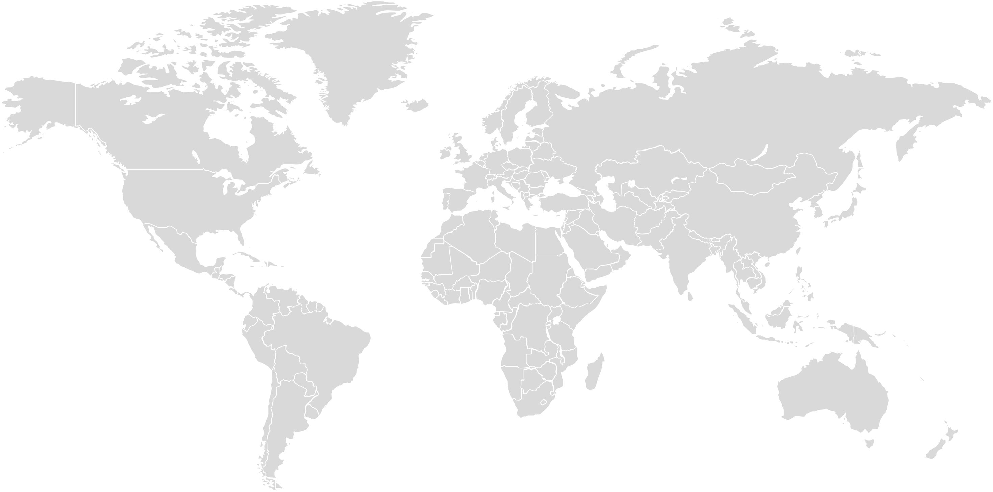
YOU CAN WRITE HERE
GRAPHIC CHART
A company is an association or collection of individuals, whether natural persons, legal persons,.
88%
12%
ASIA
75%
25%
NORTH AMERICA
59%
41%
AFRICA

Slide 83
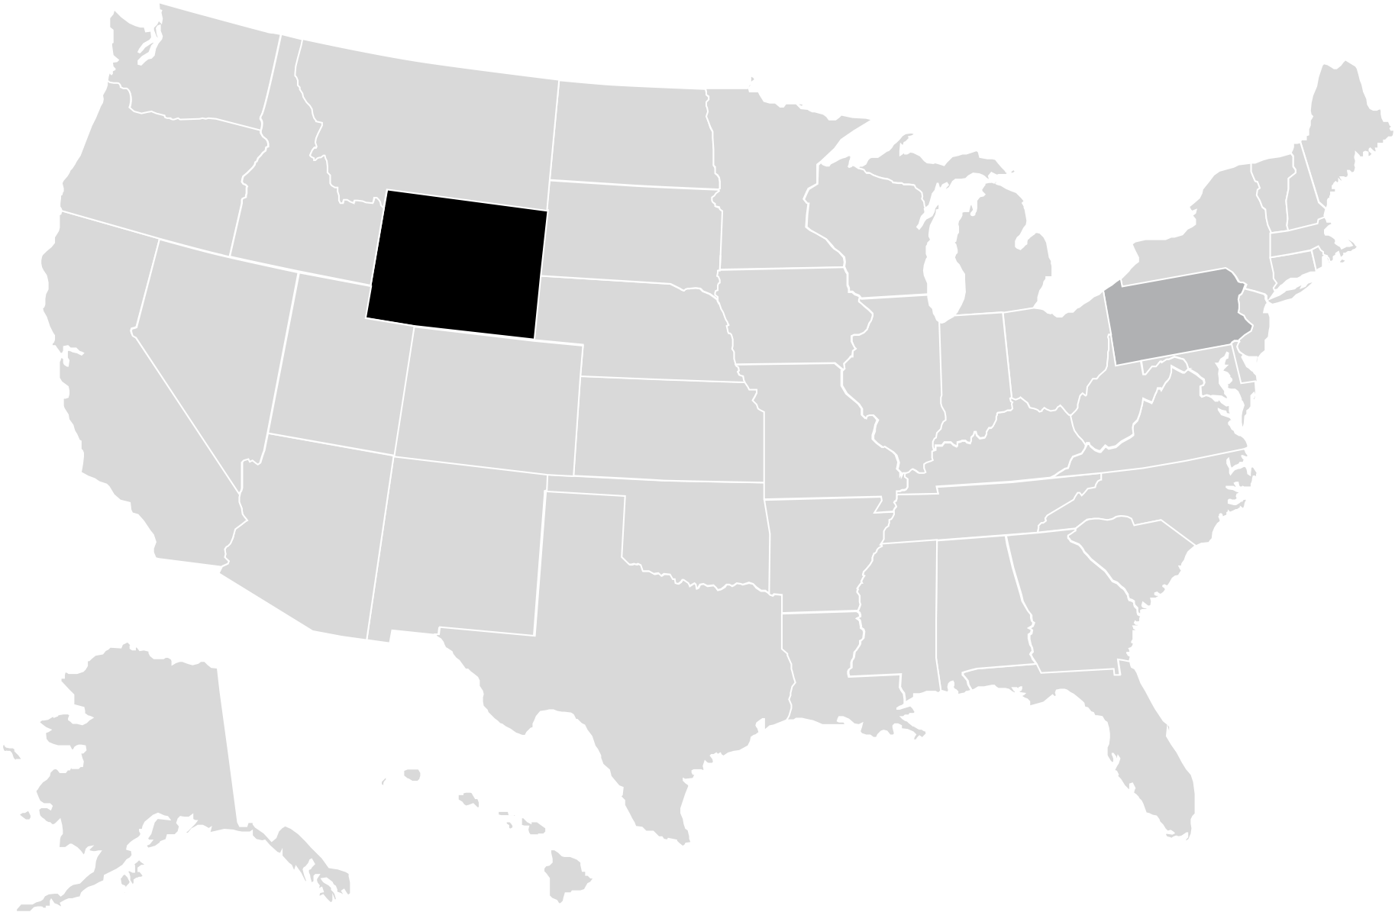
YOU CAN WRITE HERE
USA EDITABLE MAP
A company is an association or collection of individuals, whether natural persons, legal persons,.
$243BN
A company is an association or collection of individuals, whether natural persons, legal persons, or a mixture of both. Company members share a common purpose.
$178BN
A company is an association or collection of individuals, whether natural persons, legal persons, or a mixture of both. Company members share a common purpose.

Slide 84
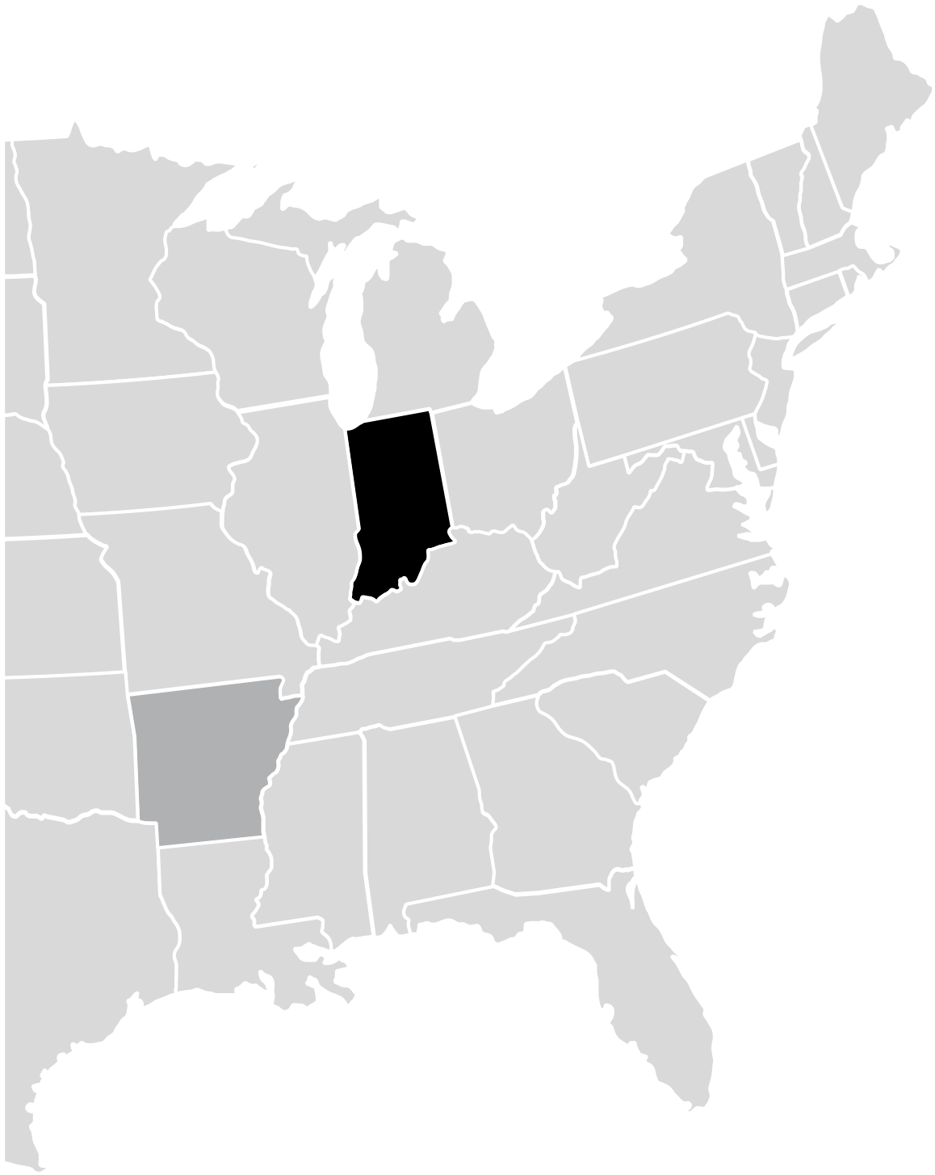
YOU CAN WRITE HERE
EAST COAST USA MAP
A company is an association or collection of individuals, whether natural persons, legal persons,.
$243BN
A company is an association or collection of individuals, whether natural persons, legal persons, or a mixture of both. Company members share a common purpose.
$178BN
A company is an association or collection of individuals, whether natural persons, legal persons, or a mixture of both. Company members share a common purpose.

Slide 85
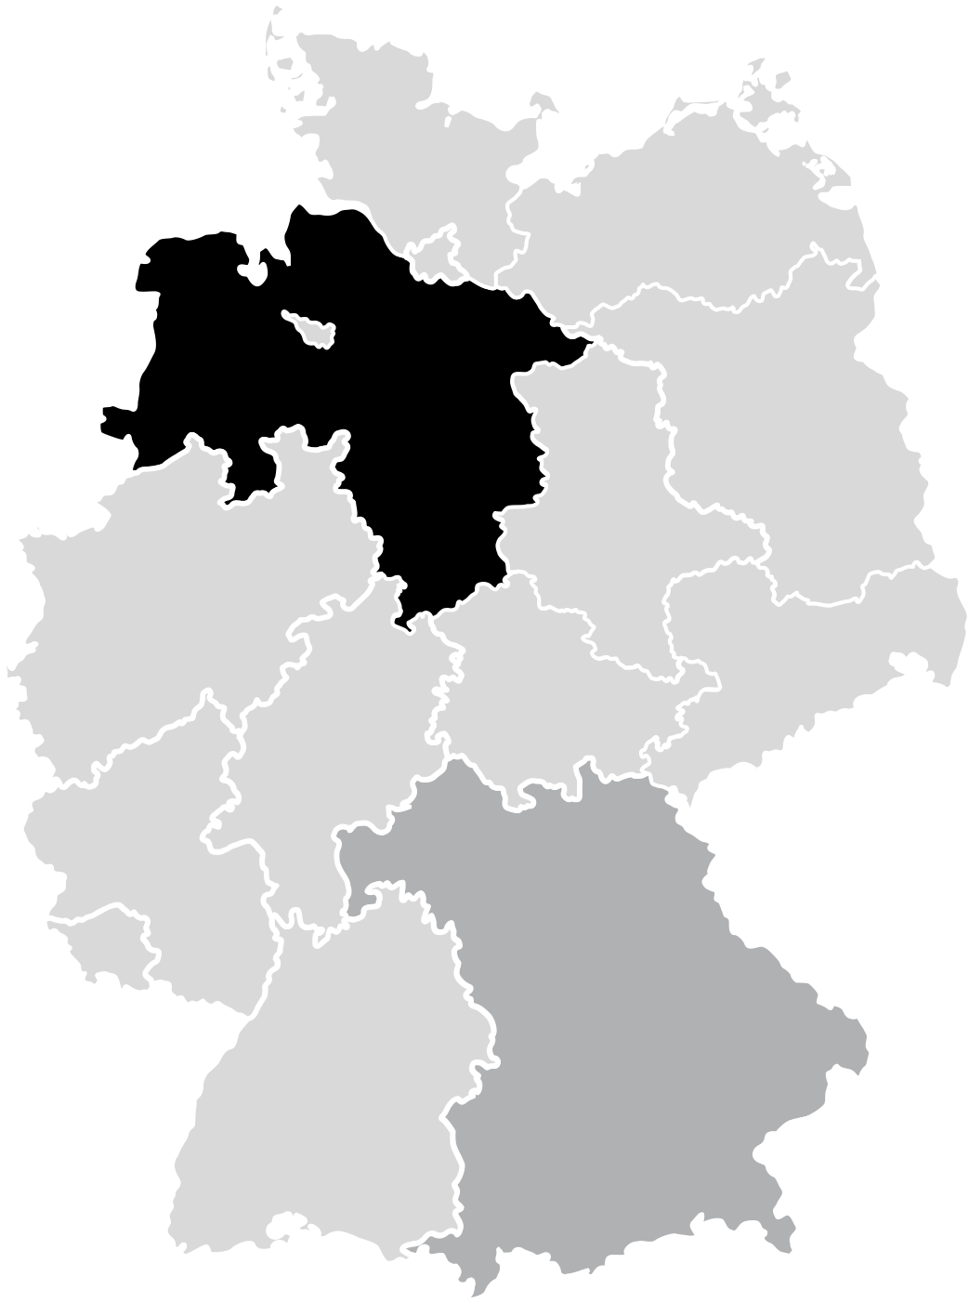
YOU CAN WRITE HERE
GERMANY EDITABLE MAP
A company is an association or collection of individuals, whether natural persons, legal persons,.
$243BN
A company is an association or collection of individuals, whether natural persons, legal persons, or a mixture of both. Company members share a common purpose.
$178BN
A company is an association or collection of individuals, whether natural persons, legal persons, or a mixture of both. Company members share a common purpose.

Slide 86
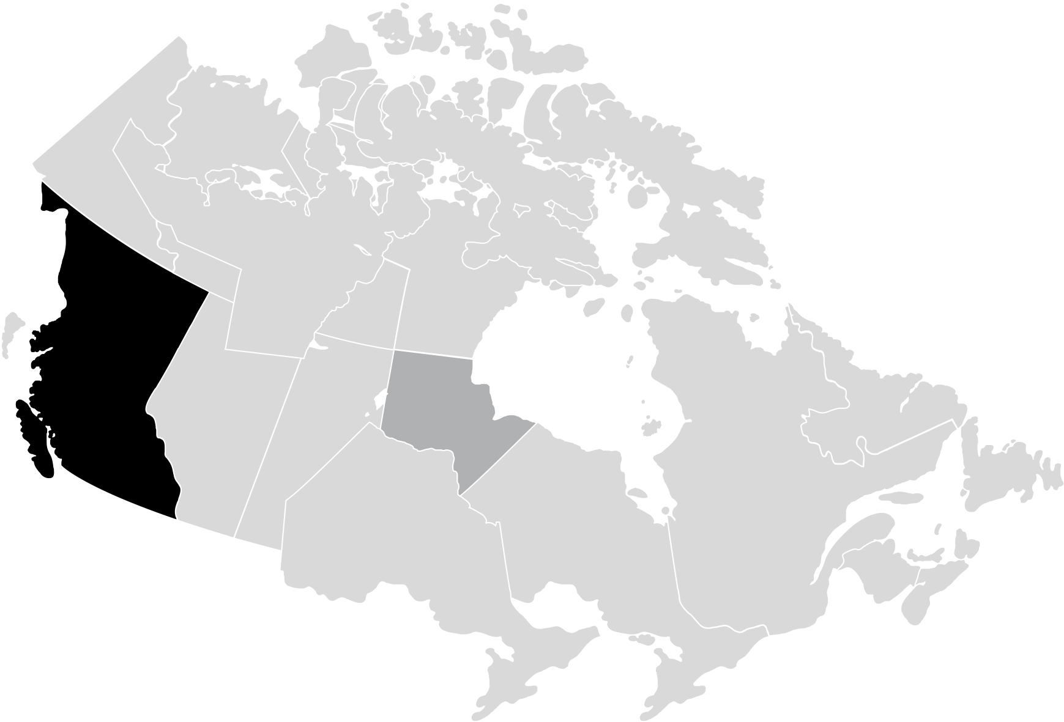
YOU CAN WRITE HERE
CANADA EDITABLE MAP
A company is an association or collection of individuals, whether natural persons, legal persons,.
$243BN
A company is an association or collection of individuals, whether natural persons, legal persons, or a mixture of both. Company members share a common purpose.
$178BN
A company is an association or collection of individuals, whether natural persons, legal persons, or a mixture of both. Company members share a common purpose.

Slide 87
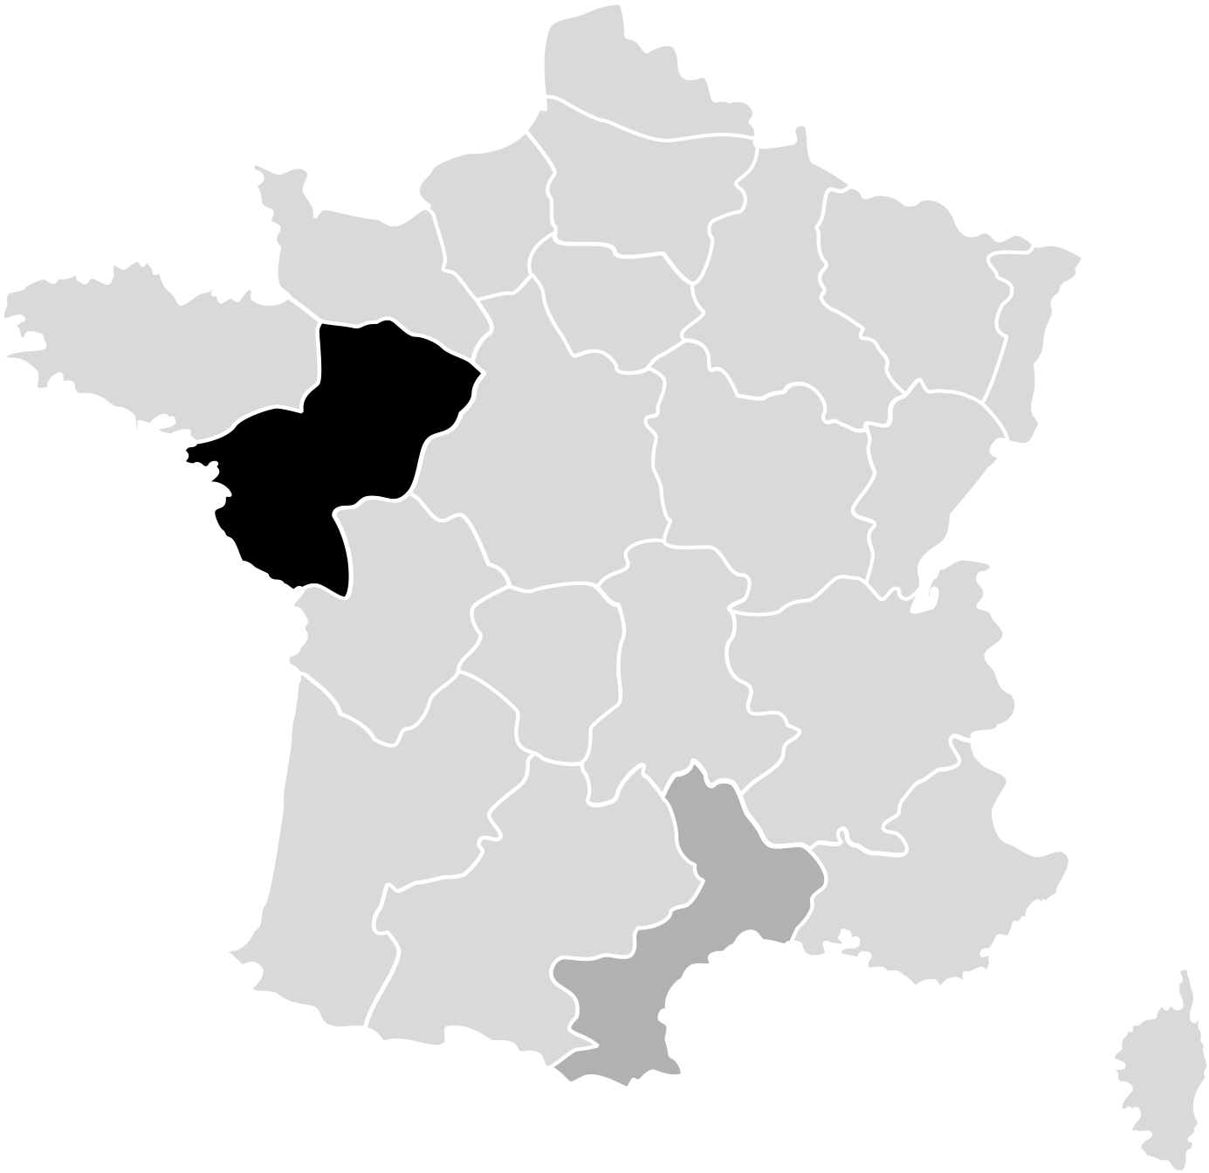
YOU CAN WRITE HERE
FRANCE EDITABLE MAP
A company is an association or collection of individuals, whether natural persons, legal persons,.
$243BN
A company is an association or collection of individuals, whether natural persons, legal persons, or a mixture of both. Company members share a common purpose.
$178BN
A company is an association or collection of individuals, whether natural persons, legal persons, or a mixture of both. Company members share a common purpose.

Slide 88
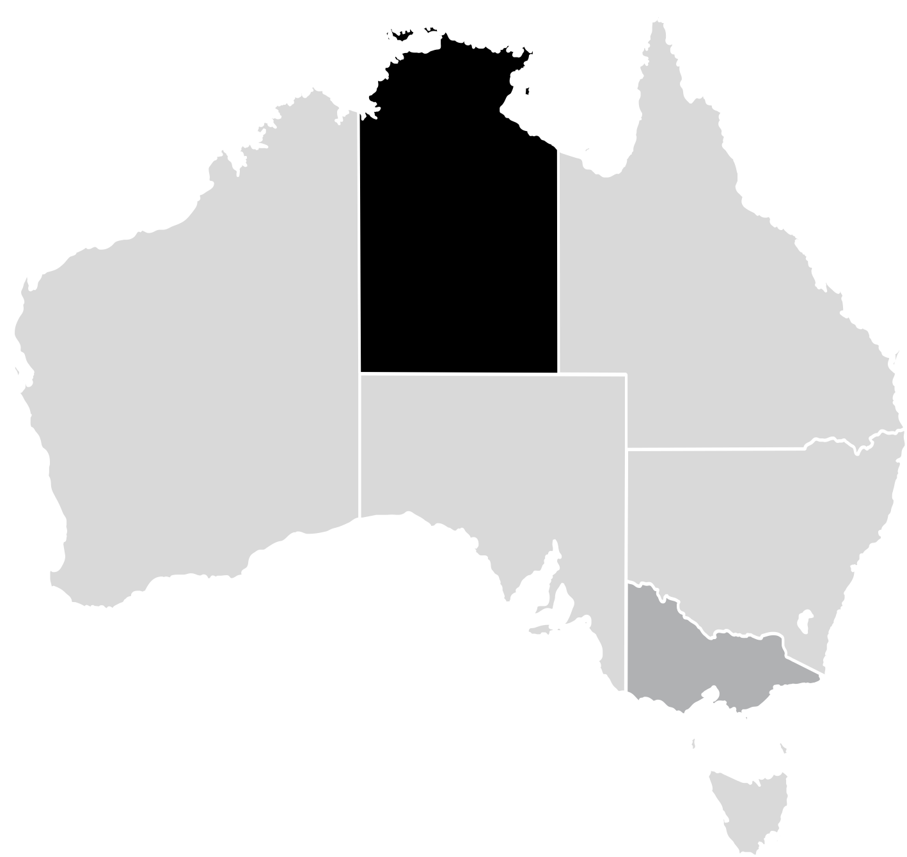
YOU CAN WRITE HERE
AUSTRALIA EDITABLE MAP
A company is an association or collection of individuals, whether natural persons, legal persons,.
$243BN
A company is an association or collection of individuals, whether natural persons, legal persons, or a mixture of both. Company members share a common purpose.
$178BN
A company is an association or collection of individuals, whether natural persons, legal persons, or a mixture of both. Company members share a common purpose.

Slide 89
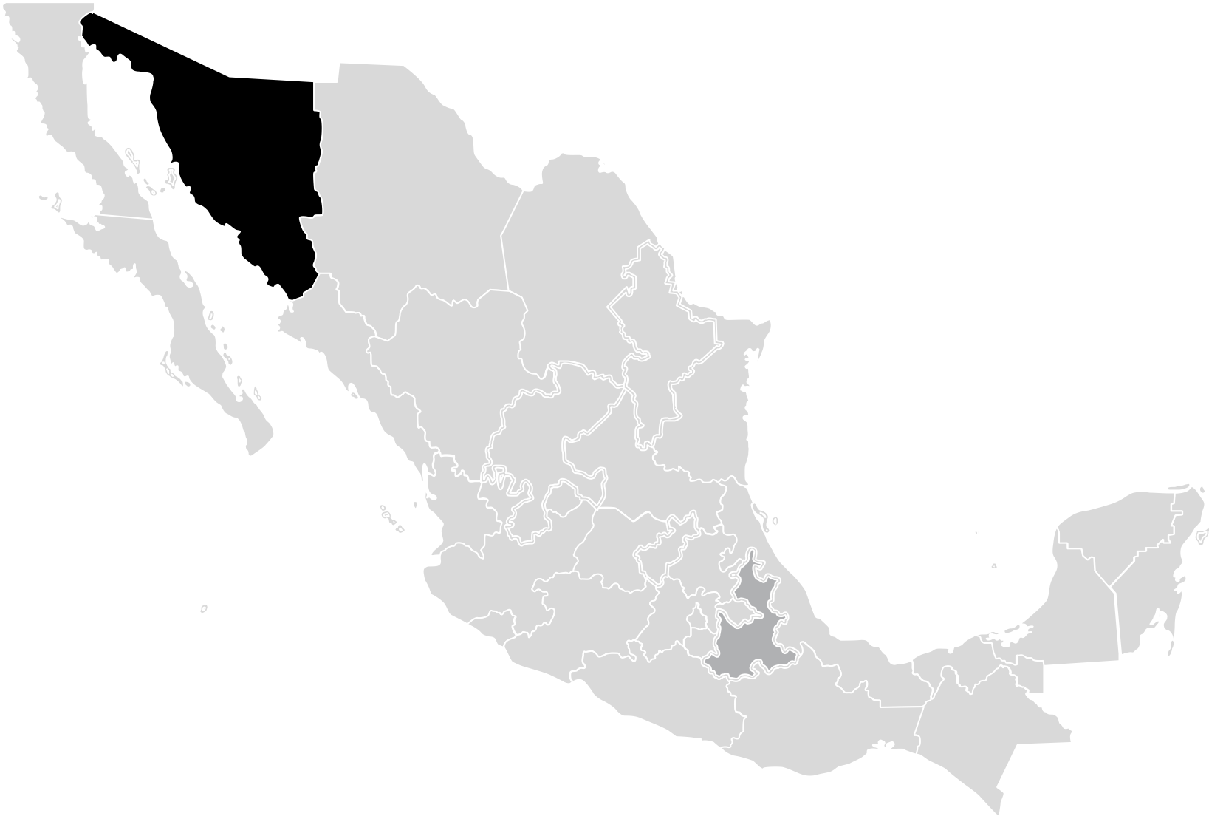
YOU CAN WRITE HERE
MEXICO EDITABLE MAP
A company is an association or collection of individuals, whether natural persons, legal persons,.
$243BN
A company is an association or collection of individuals, whether natural persons, legal persons, or a mixture of both. Company members share a common purpose.
$178BN
A company is an association or collection of individuals, whether natural persons, legal persons, or a mixture of both. Company members share a common purpose.

Slide 90
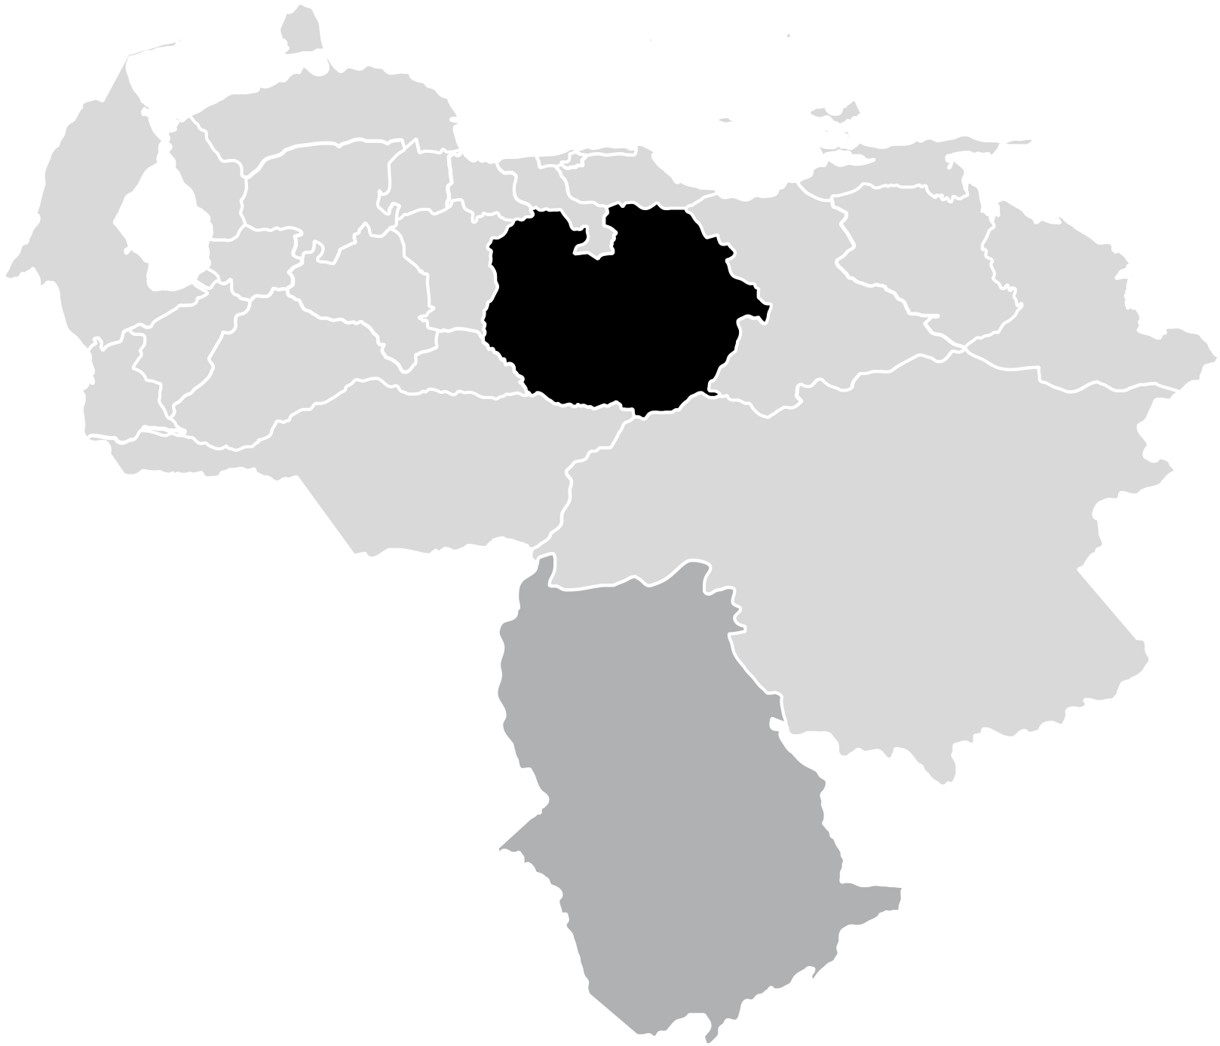
YOU CAN WRITE HERE
VENEZUELA EDITABLE MAP
A company is an association or collection of individuals, whether natural persons, legal persons,.
$243BN
A company is an association or collection of individuals, whether natural persons, legal persons, or a mixture of both. Company members share a common purpose.
$178BN
A company is an association or collection of individuals, whether natural persons, legal persons, or a mixture of both. Company members share a common purpose.

Slide 91
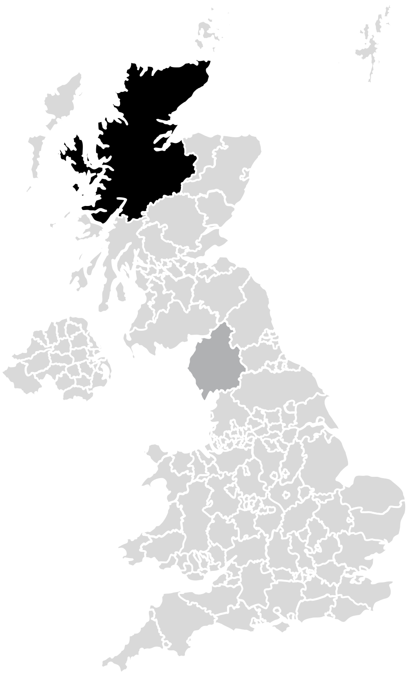
YOU CAN WRITE HERE
UNITED KINGDOM EDITABLE MAP
A company is an association or collection of individuals, whether natural persons, legal persons,.
$243BN
A company is an association or collection of individuals, whether natural persons, legal persons, or a mixture of both. Company members share a common purpose.
$178BN
A company is an association or collection of individuals, whether natural persons, legal persons, or a mixture of both. Company members share a common purpose.

Slide 92
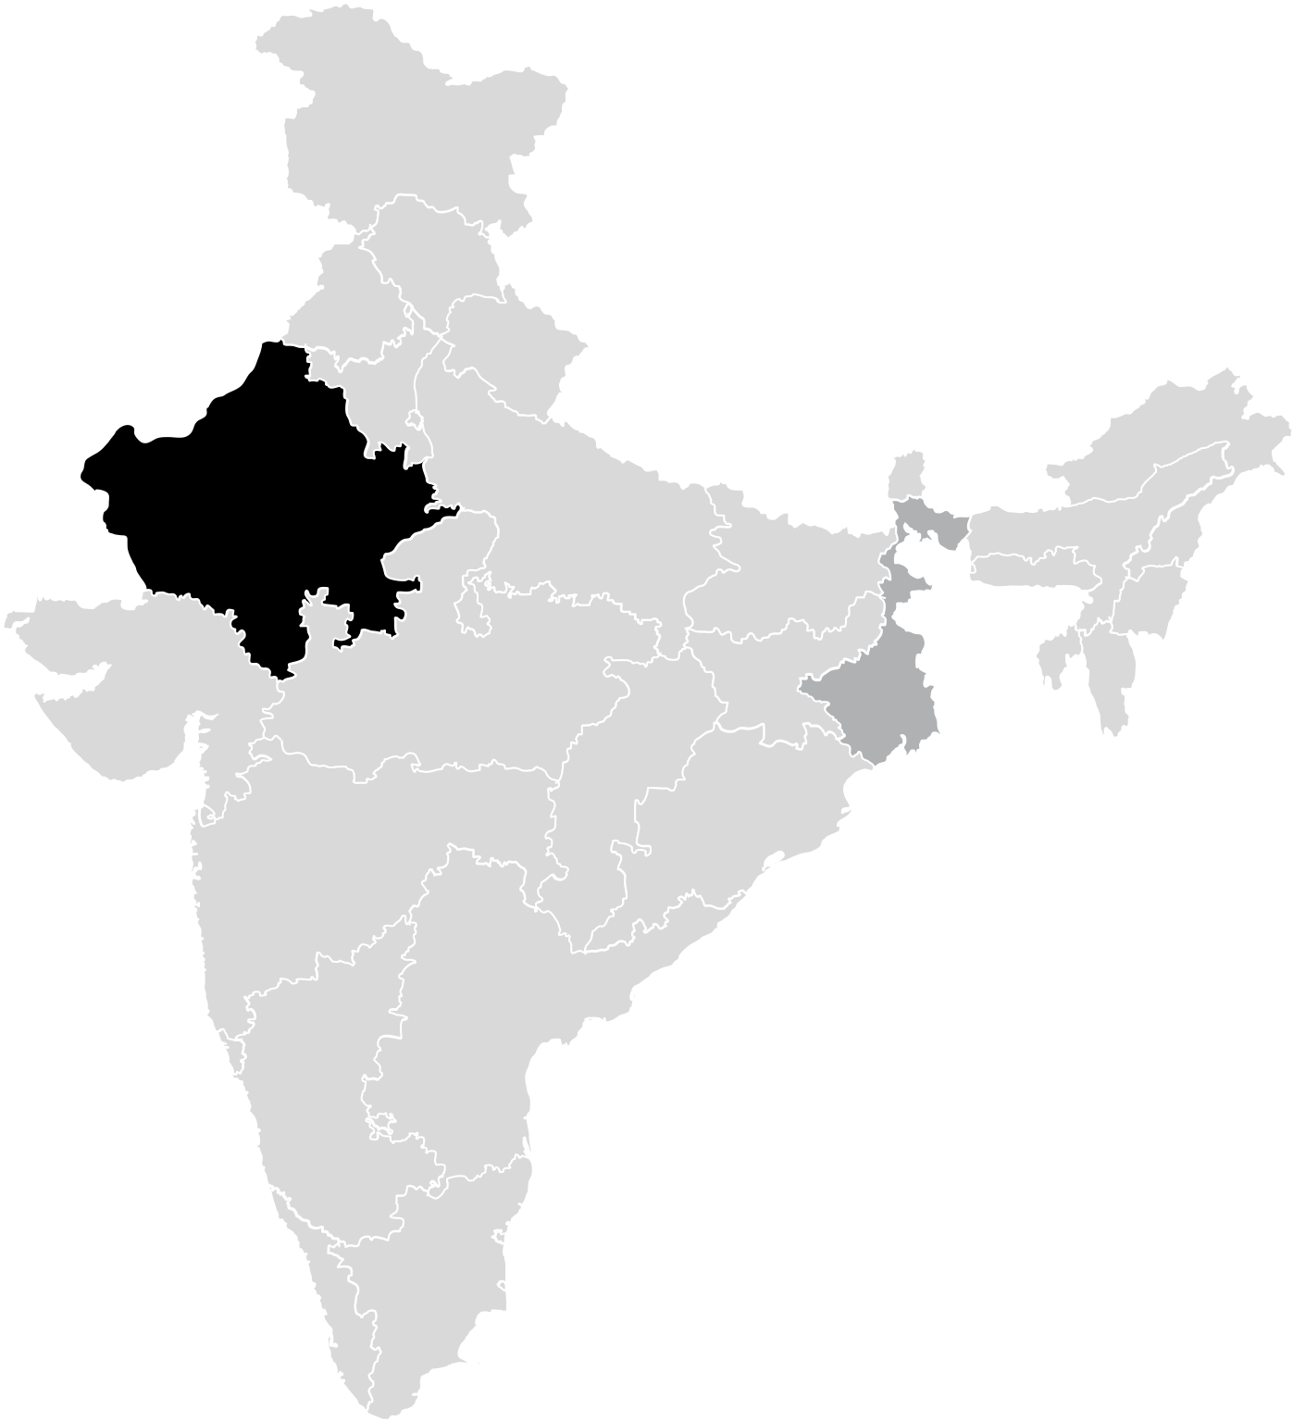
YOU CAN WRITE HERE
INDIA EDITABLE MAP
A company is an association or collection of individuals, whether natural persons, legal persons,.
$243BN
A company is an association or collection of individuals, whether natural persons, legal persons, or a mixture of both. Company members share a common purpose.
$178BN
A company is an association or collection of individuals, whether natural persons, legal persons, or a mixture of both. Company members share a common purpose.

Slide 93
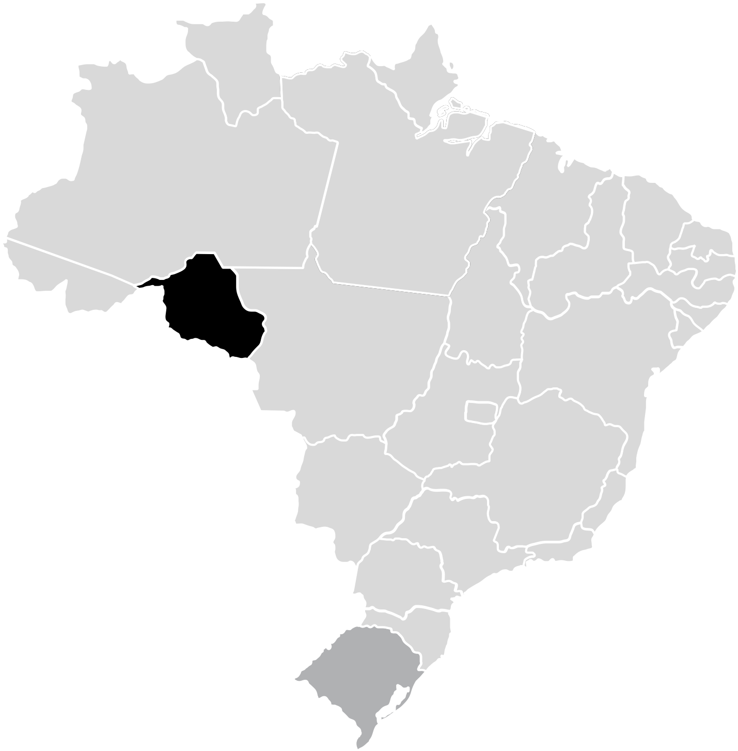
YOU CAN WRITE HERE
BRAZIL EDITABLE MAP
A company is an association or collection of individuals, whether natural persons, legal persons,.
$243BN
A company is an association or collection of individuals, whether natural persons, legal persons, or a mixture of both. Company members share a common purpose.
$178BN
A company is an association or collection of individuals, whether natural persons, legal persons, or a mixture of both. Company members share a common purpose.

Slide 94
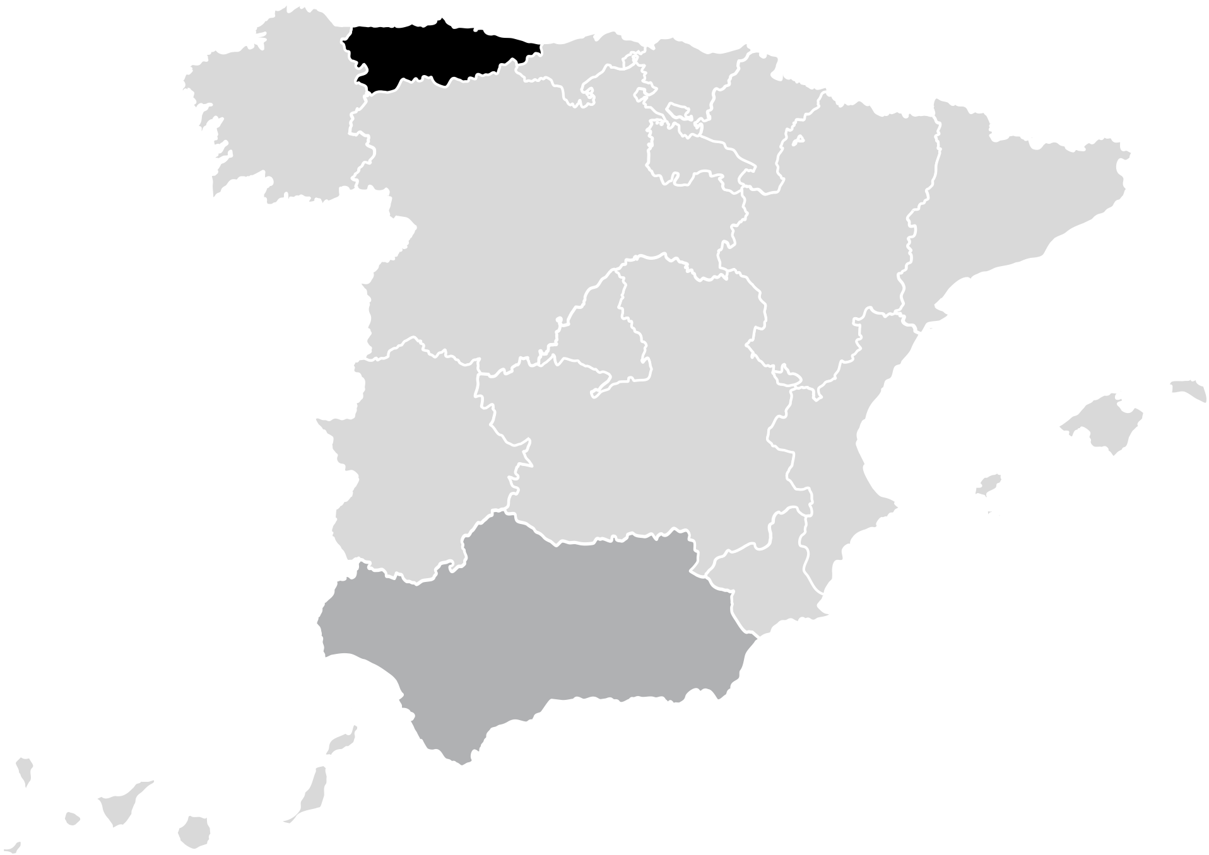
YOU CAN WRITE HERE
SPAIN EDITABLE MAP
A company is an association or collection of individuals, whether natural persons, legal persons,.
$243BN
A company is an association or collection of individuals, whether natural persons, legal persons, or a mixture of both. Company members share a common purpose.
$178BN
A company is an association or collection of individuals, whether natural persons, legal persons, or a mixture of both. Company members share a common purpose.

Slide 95
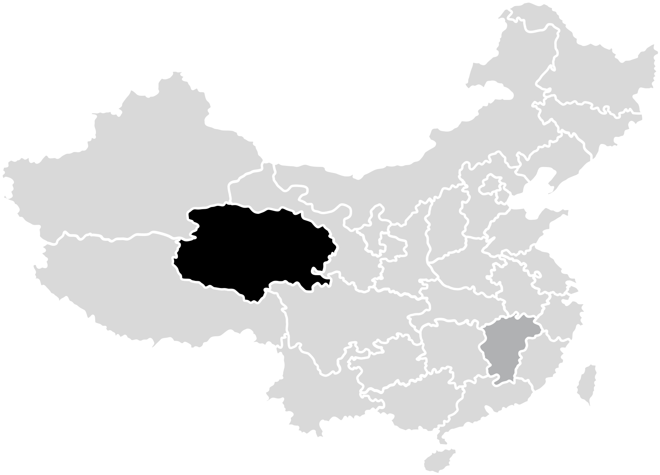
YOU CAN WRITE HERE
CHINA EDITABLE MAP
A company is an association or collection of individuals, whether natural persons, legal persons,.
$243BN
A company is an association or collection of individuals, whether natural persons, legal persons, or a mixture of both. Company members share a common purpose.
$178BN
A company is an association or collection of individuals, whether natural persons, legal persons, or a mixture of both. Company members share a common purpose.

Slide 96
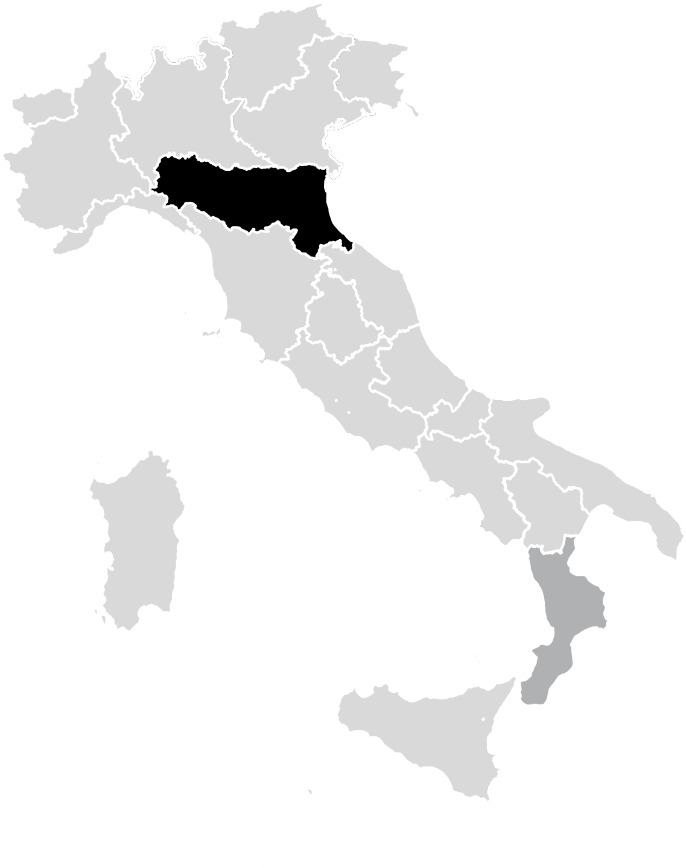
YOU CAN WRITE HERE
ITALY EDITABLE MAP
A company is an association or collection of individuals, whether natural persons, legal persons,.
$243BN
A company is an association or collection of individuals, whether natural persons, legal persons, or a mixture of both. Company members share a common purpose.
$178BN
A company is an association or collection of individuals, whether natural persons, legal persons, or a mixture of both. Company members share a common purpose.

Slide 97
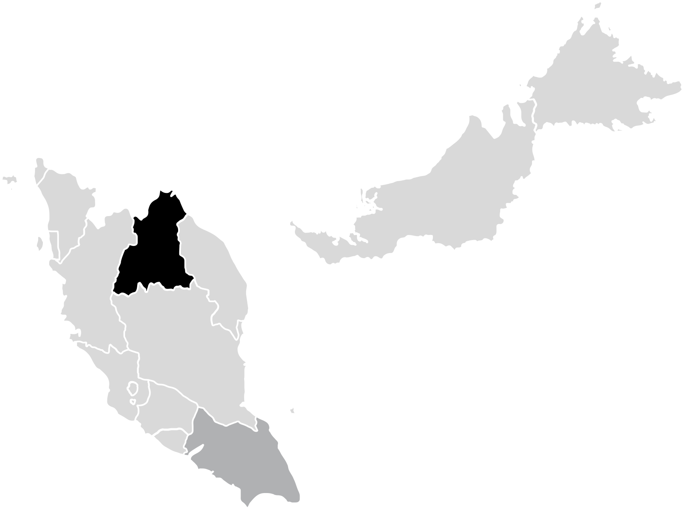
YOU CAN WRITE HERE
MALAYSIA EDITABLE MAP
A company is an association or collection of individuals, whether natural persons, legal persons,.
$243BN
A company is an association or collection of individuals, whether natural persons, legal persons, or a mixture of both. Company members share a common purpose.
$178BN
A company is an association or collection of individuals, whether natural persons, legal persons, or a mixture of both. Company members share a common purpose.

Slide 98
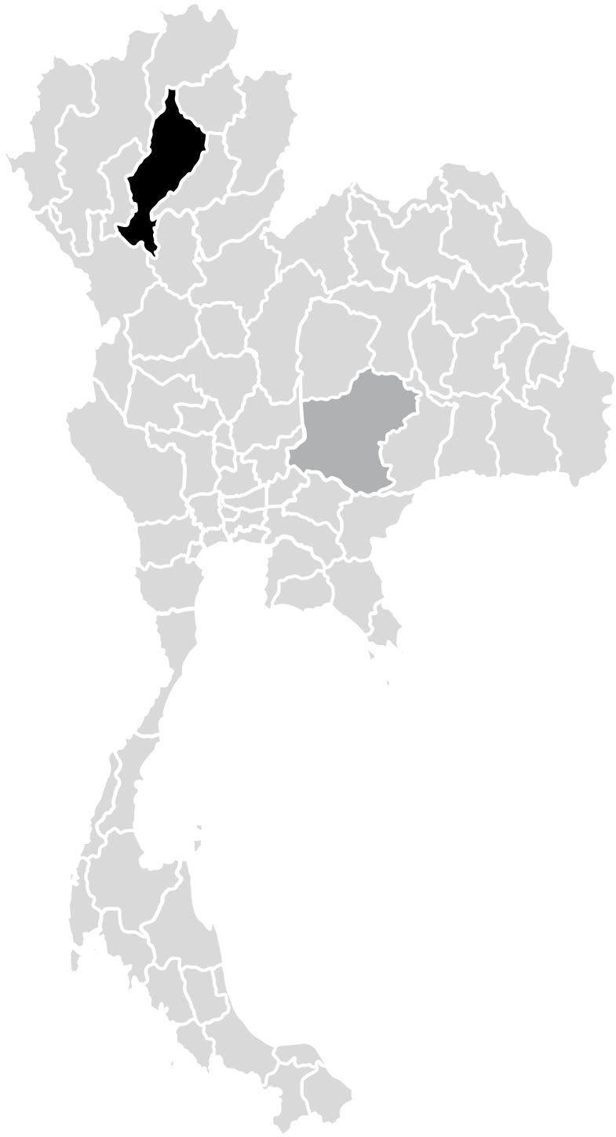
YOU CAN WRITE HERE
THAILAND EDITABLE MAP
A company is an association or collection of individuals, whether natural persons, legal persons,.
$243BN
A company is an association or collection of individuals, whether natural persons, legal persons, or a mixture of both. Company members share a common purpose.
$178BN
A company is an association or collection of individuals, whether natural persons, legal persons, or a mixture of both. Company members share a common purpose.

Slide 99

YOU CAN WRITE HERE
SOUTH EAST EDITABLE MAP
A company is an association or collection of individuals, whether natural persons, legal persons,.
$243BN
A company is an association or collection of individuals, whether natural persons, legal persons, or a mixture of both. Company members share a common purpose.
$178BN
A company is an association or collection of individuals, whether natural persons, legal persons, or a mixture of both. Company members share a common purpose.

Slide 100
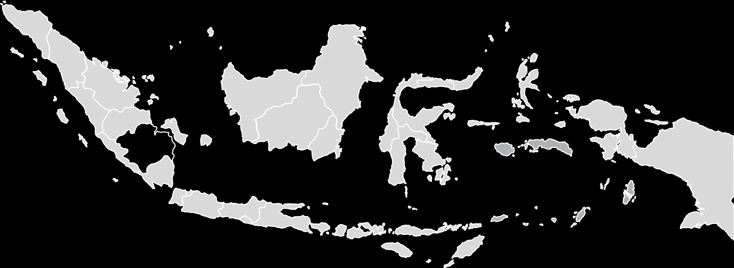
YOU CAN WRITE HERE
INDONESIA EDITABLE MAP
A company is an association or collection of individuals, whether natural persons, legal persons,.
15%
Company members share a common purpose and unite in order to focus their various talents and organize their
FIRST TITLE Entrepreneurial activities differ substantially depending on the.
SECOND TITLE Entrepreneurial activities differ substantially depending on the.

Slide 101
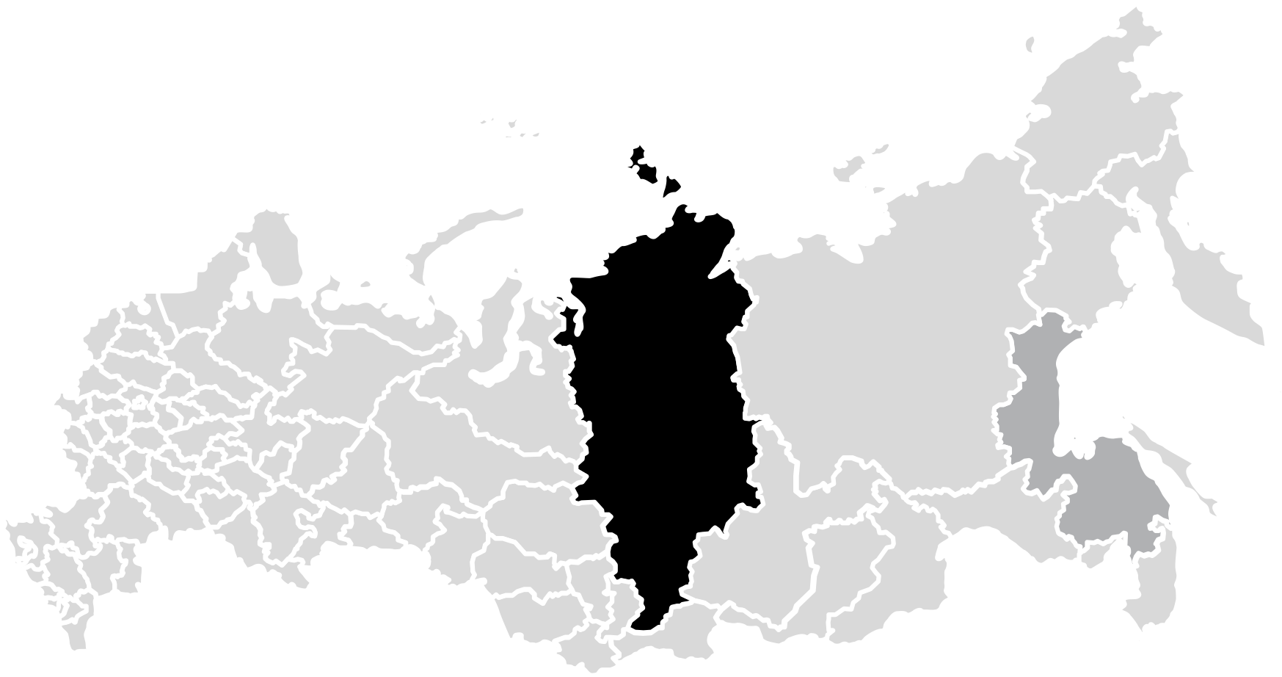
YOU CAN WRITE HERE
RUSSIA EDITABLE MAP
A company is an association or collection of individuals, whether natural persons, legal persons,.
$243BN
A company is an association or collection of individuals, whether natural persons, legal persons, or a mixture of both. Company members share a common purpose.
$178BN
A company is an association or collection of individuals, whether natural persons, legal persons, or a mixture of both. Company members share a common purpose.

Slide 102
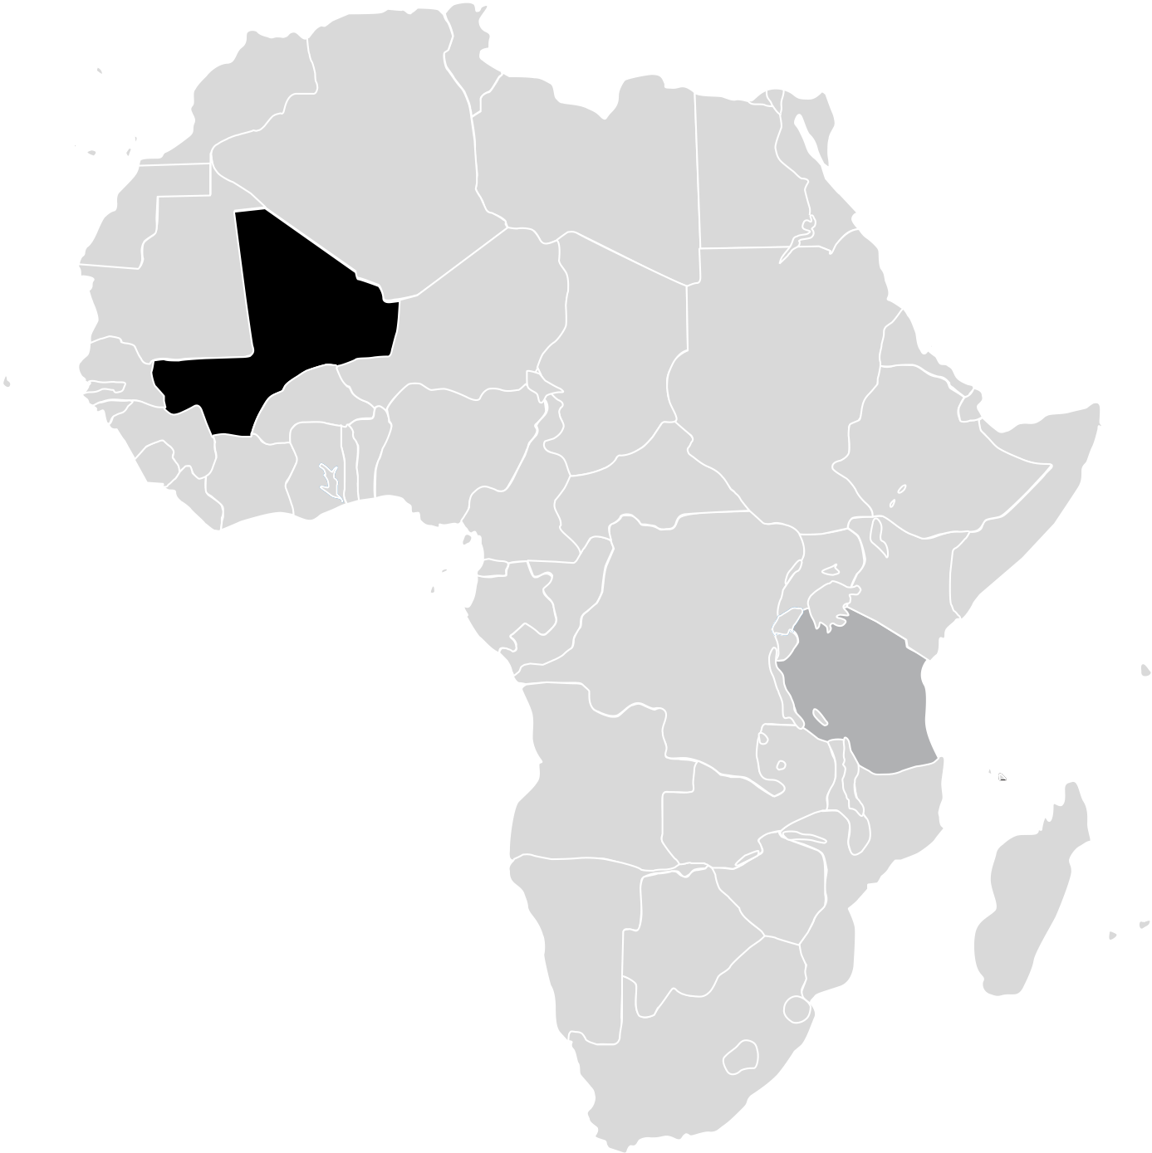
YOU CAN WRITE HERE
AFRICA EDITABLE MAP
A company is an association or collection of individuals, whether natural persons, legal persons,.
$243BN
A company is an association or collection of individuals, whether natural persons, legal persons, or a mixture of both. Company members share a common purpose.
$178BN
A company is an association or collection of individuals, whether natural persons, legal persons, or a mixture of both. Company members share a common purpose.

Slide 103
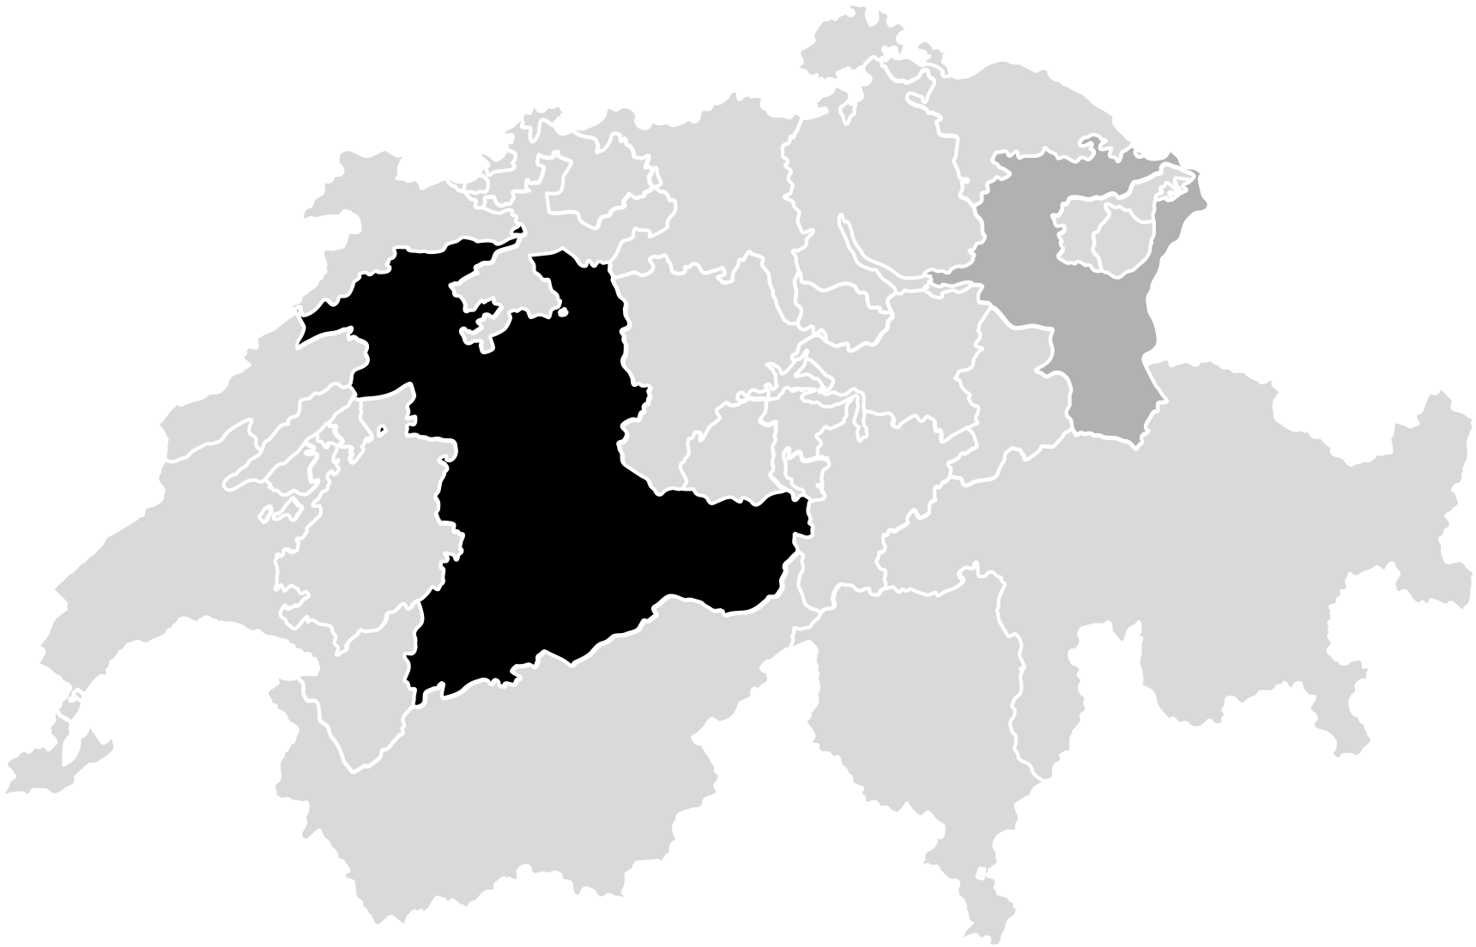
YOU CAN WRITE HERE
RUSSIA EDITABLE MAP
A company is an association or collection of individuals, whether natural persons, legal persons,.
$243BN
A company is an association or collection of individuals, whether natural persons, legal persons, or a mixture of both. Company members share a common purpose.
$178BN
A company is an association or collection of individuals, whether natural persons, legal persons, or a mixture of both. Company members share a common purpose.

Slide 104
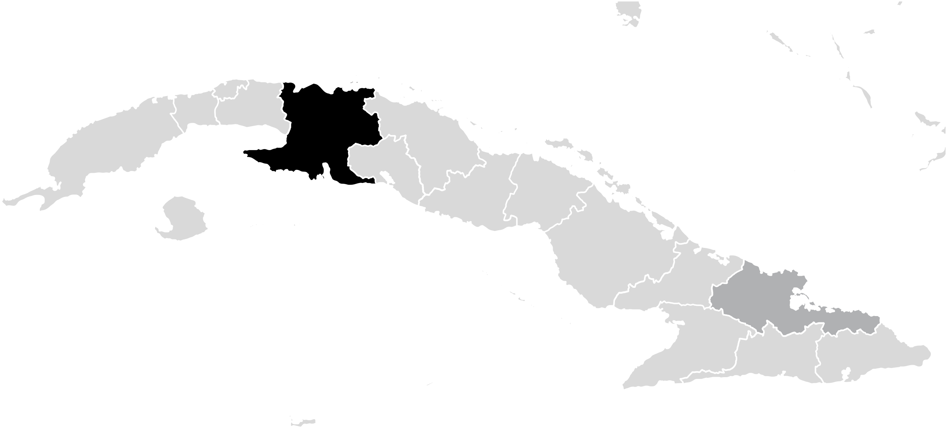
YOU CAN WRITE HERE
CUBA EDITABLE MAP
A company is an association or collection of individuals, whether natural persons, legal persons,.
15%
Company members share a common purpose and unite in order to focus their various talents and organize their
FIRST TITLE Entrepreneurial activities differ substantially depending on the.
SECOND TITLE Entrepreneurial activities differ substantially depending on the.

Slide 105
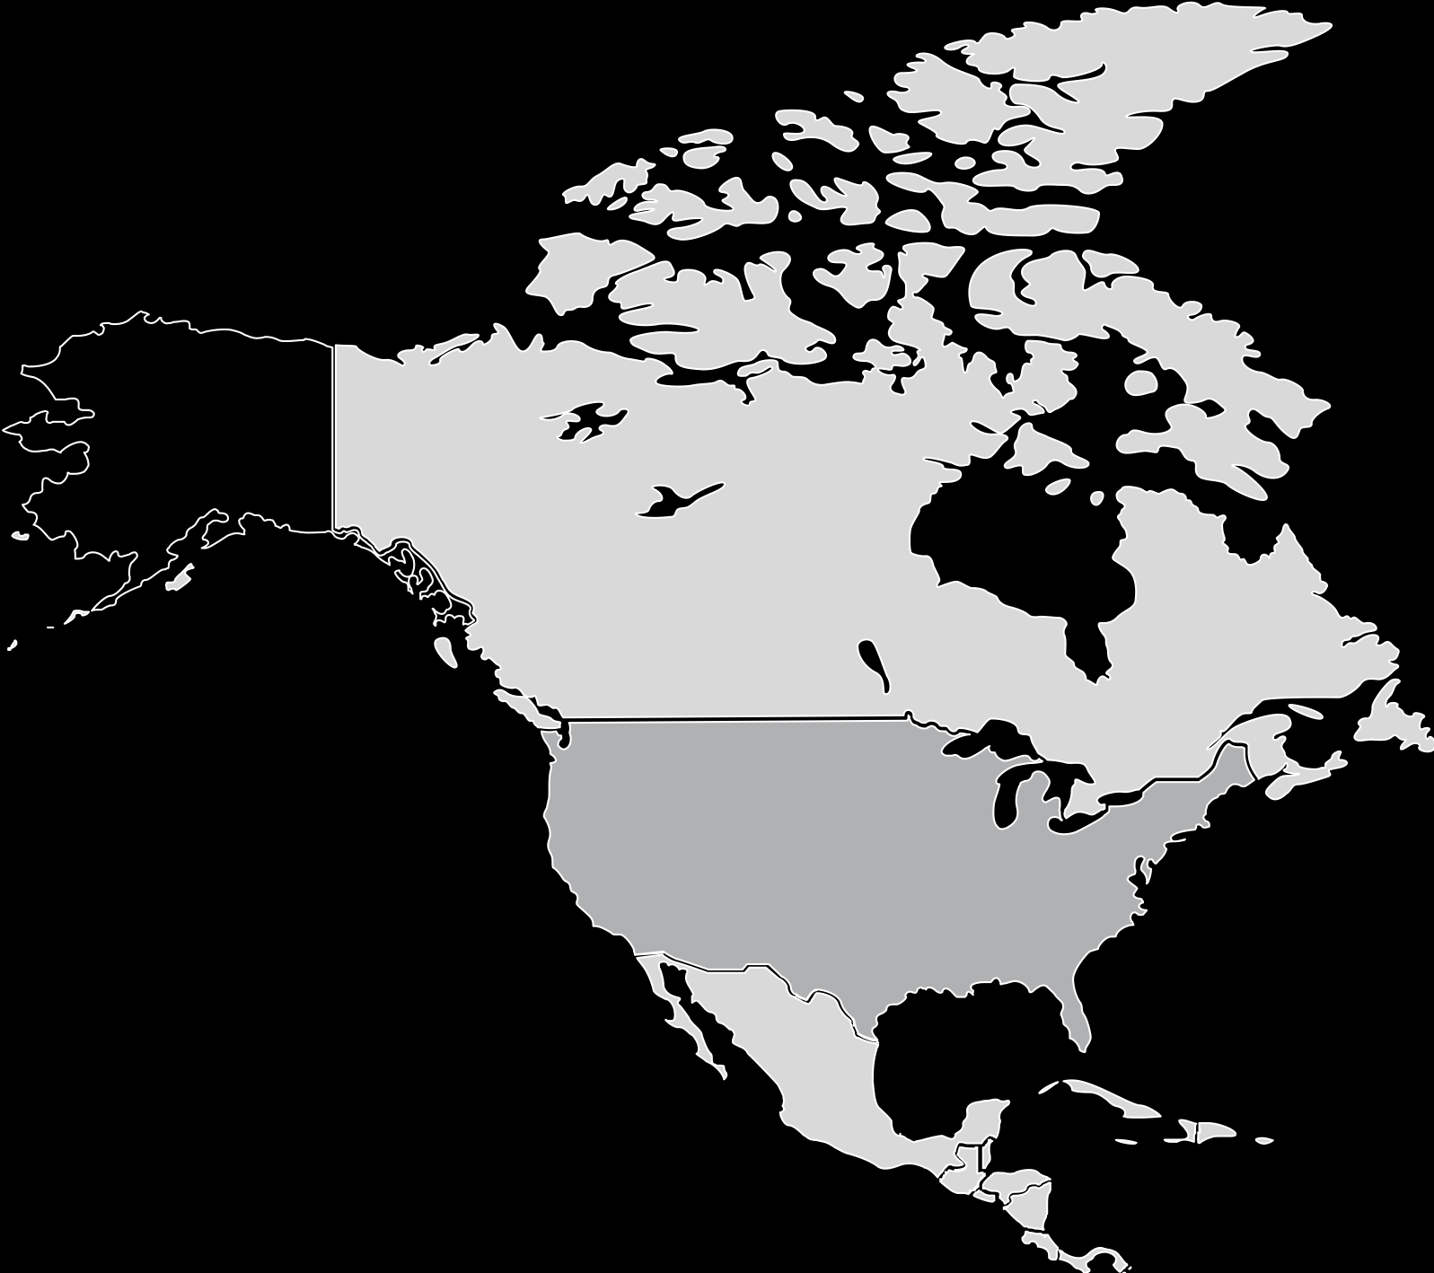
YOU CAN WRITE HERE
NORTH AMERICA EDITABLE MAP
A company is an association or collection of individuals, whether natural persons, legal persons,.
$243BN
A company is an association or collection of individuals, whether natural persons, legal persons, or a mixture of both. Company members share a common purpose.
$178BN
A company is an association or collection of individuals, whether natural persons, legal persons, or a mixture of both. Company members share a common purpose.

Slide 106
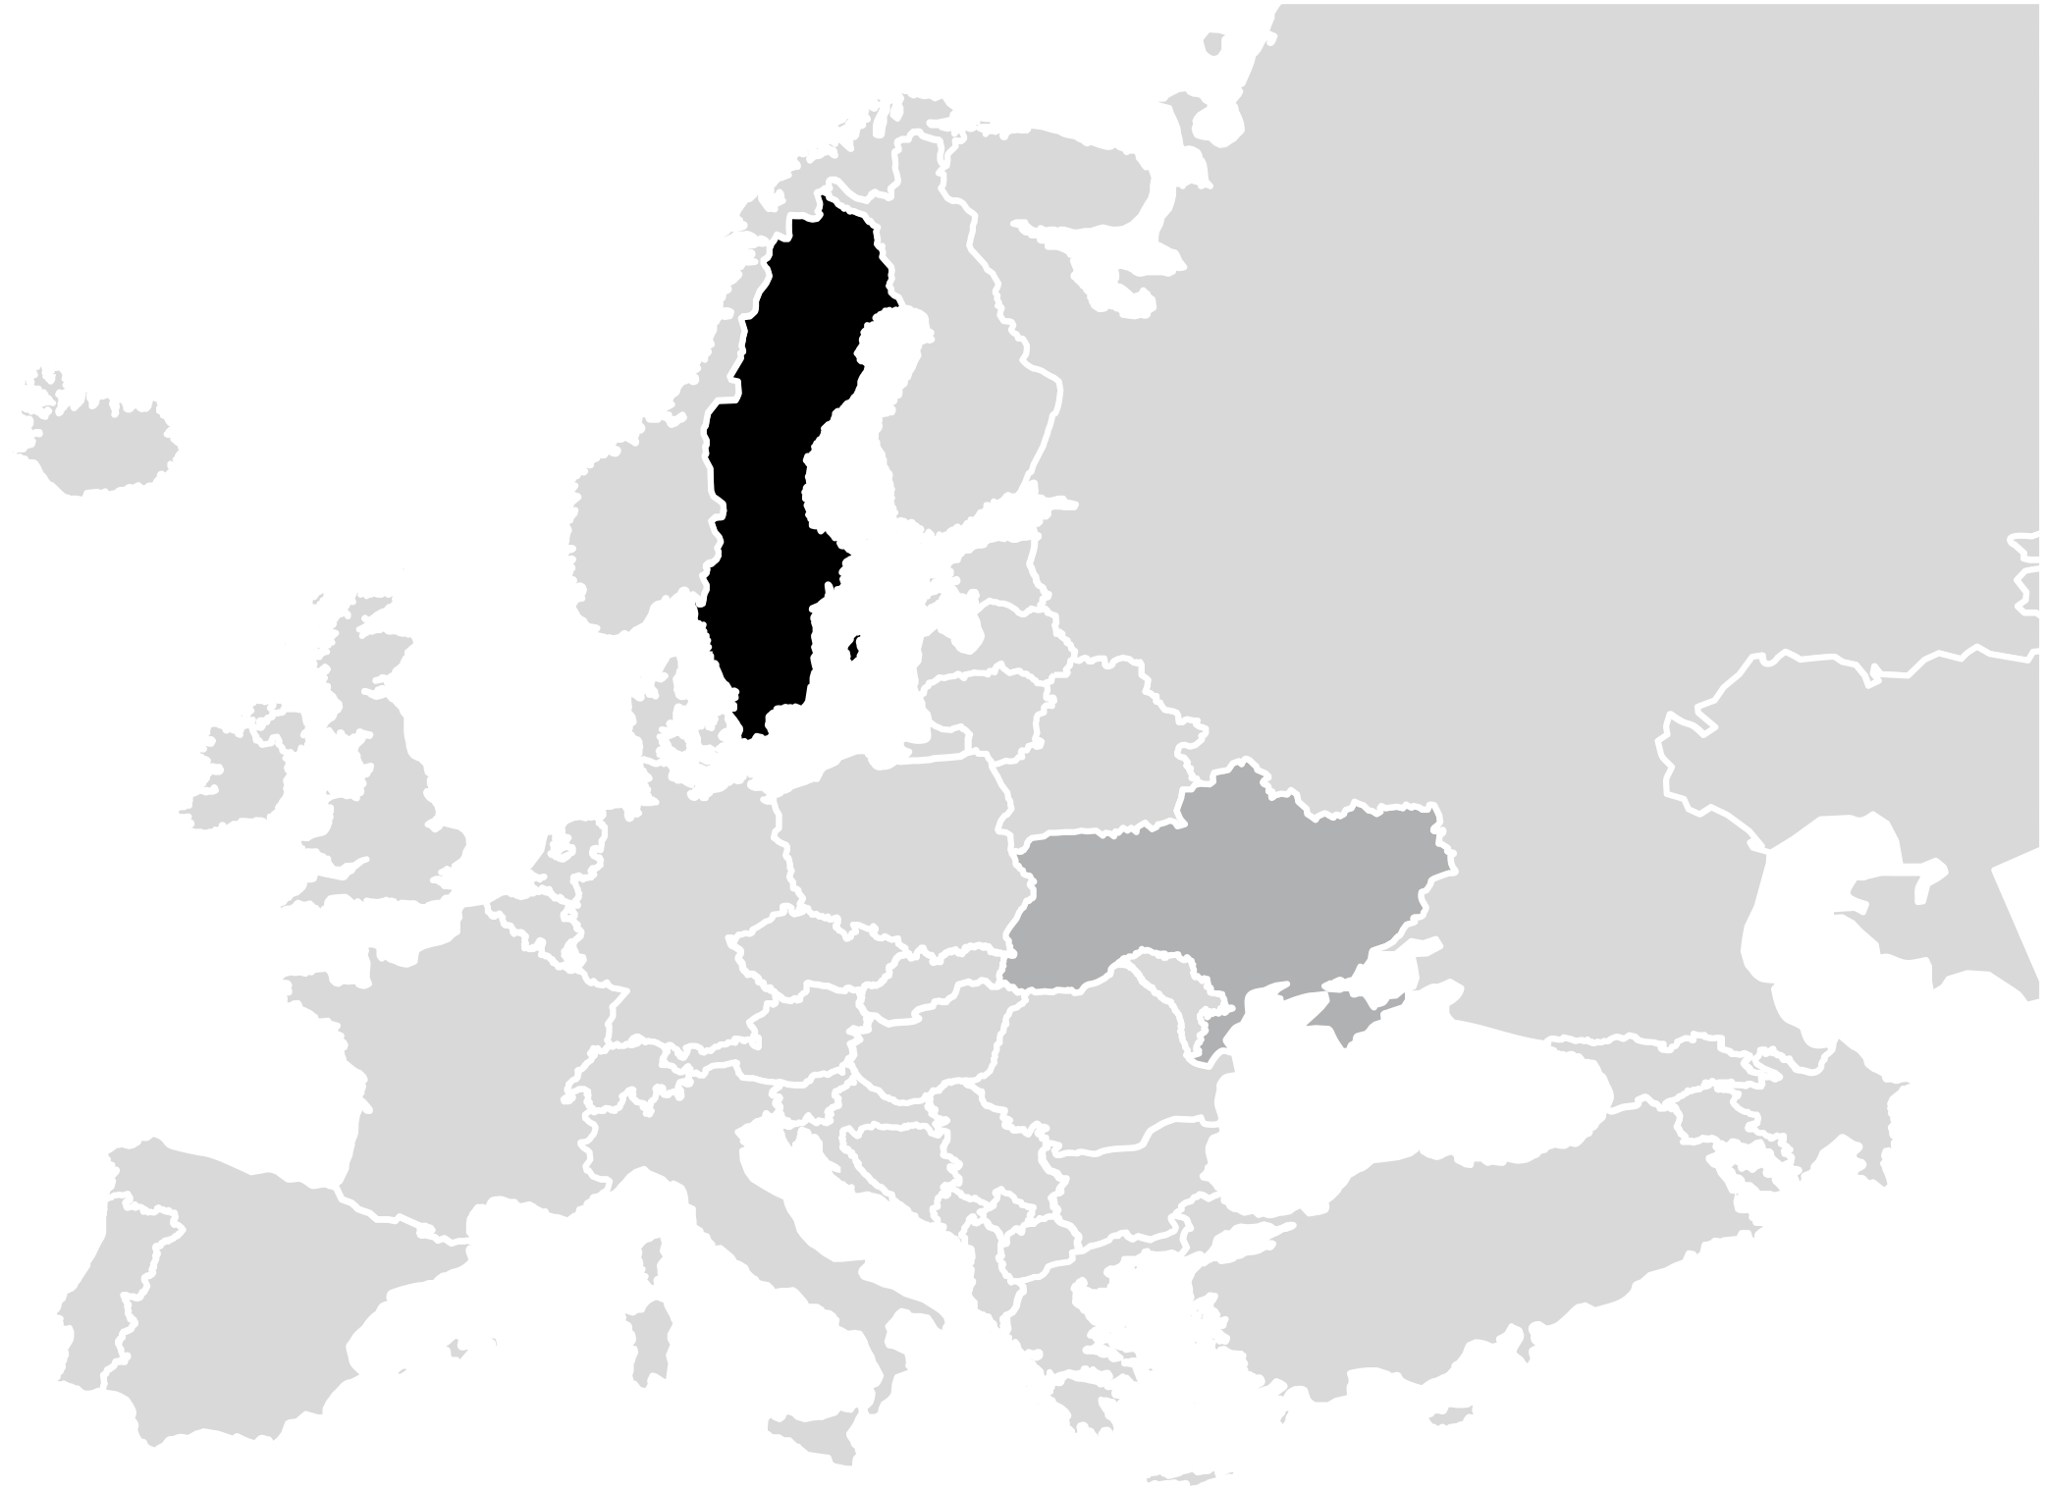
YOU CAN WRITE HERE
EUROPE EDITABLE MAP
A company is an association or collection of individuals, whether natural persons, legal persons,.
$243BN
A company is an association or collection of individuals, whether natural persons, legal persons, or a mixture of both. Company members share a common purpose.
$178BN
A company is an association or collection of individuals, whether natural persons, legal persons, or a mixture of both. Company members share a common purpose.

Slide 107
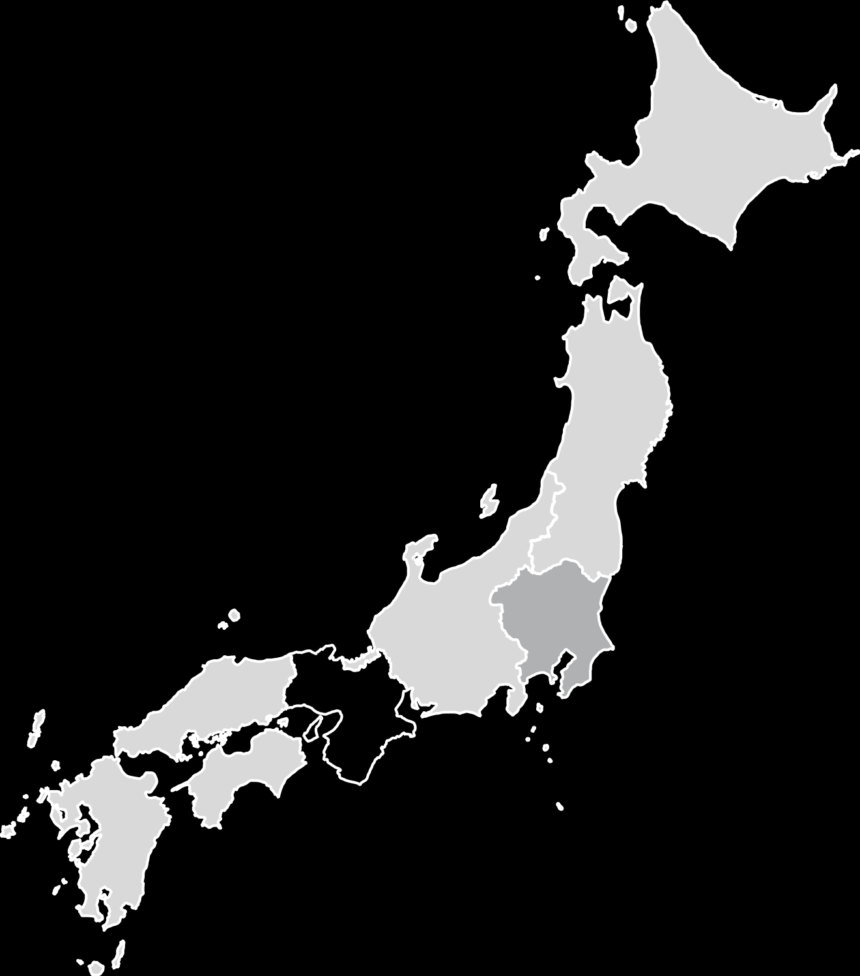
YOU CAN WRITE HERE
JAPAN EDITABLE MAP
A company is an association or collection of individuals, whether natural persons, legal persons,.
$243BN
A company is an association or collection of individuals, whether natural persons, legal persons, or a mixture of both. Company members share a common purpose.
$178BN
A company is an association or collection of individuals, whether natural persons, legal persons, or a mixture of both. Company members share a common purpose.

Slide 108
Get in Touch
A company is an association or collection of individuals, whether natural persons, legal persons, or a mixture of both. Company members share a common purpose.
EMPIRES BUILDING
7788 NEW YORK CITY, US
1-800-GHOST
WEAREGHOST
GHOST.COM
Entrepreneurial activities differ substantially depending on the
Entrepreneurial activities differ substantially depending on the
Entrepreneurial activities differ substantially depending on the

Slide 109
General

Slide 110
Electronics
Miscellaneous

Slide 111
E-Commerce
Web

Slide 112
Arrows
Location
Weather

